Slide 1
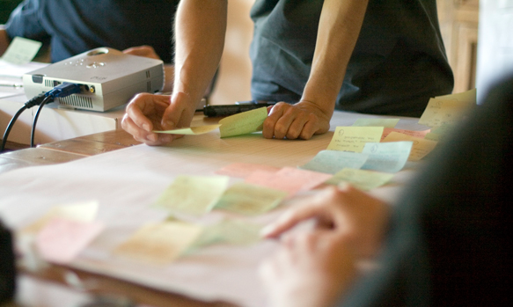
http://flic.kr/p/6sdZDR
Software Requirements

Slide 2
What customers want...
Software that
Meets their needs,
On time,
and
On budget
Requirements!

Slide 3
Software Requirements
"express the needs and constraints placed on a software product that contribute to the solution of some real-world problem"
Source: SWEBOK Version 3.0

Slide 4
Requirements Problems
Missing/incorrect requirements
Changing requirements
Ambiguous/conflicting requirements
Untestable requirements
Too many requirements ("bag of leaves")
Loss of traceability (back to source and forward to implementation)

Slide 5
Software Requirements SWEBOK Knowledge Area
Elicitation: Where to get them, how to gather
Analysis: Categorizing, modeling, resolving conflicts
Specification: Documenting
Validation: Checking correctness
Management: Coping with change, traceability
Source: SWEBOK Version 3.0

Slide 6
Types of Requirements
Functional: "functions that the software is to execute"
AKA capabilities or features
Non-functional: "act to constrain the solution"
AKA constraints or quality requirements
Examples: usability, reliability, performance
AKA the “-ilities”
Source: SWEBOK Version 3.0

Slide 7
FURPS Classification
Functional: features, capabilities, security
Usability: human factors, help, documentation
Reliability: frequency of failure, recoverability, predictability
Performance: response times, throughput, accuracy, availability, resource usage
Supportability: adaptability, maintainability, internationalization, configurability
Non-functional requirements

Slide 8
Types of Requirements
Functional: "functions that the software is to execute"
AKA capabilities or features
Non-functional: "act to constrain the solution"
AKA constraints or quality requirements
Examples: usability, reliability, performance
AKA the “ilities”
Our focus!
Source: SWEBOK Version 3.0

Slide 9
Functional Requirements: Key Problems of Interest
Figure out what features customers want
Not make false/incorrect assumptions
Document requirements to facilitate communication
Within team and with customers
Chunk work into bite-sized pieces
So work can be divided up
So system can be built incrementally
So estimates are remotely accurate

Slide 10
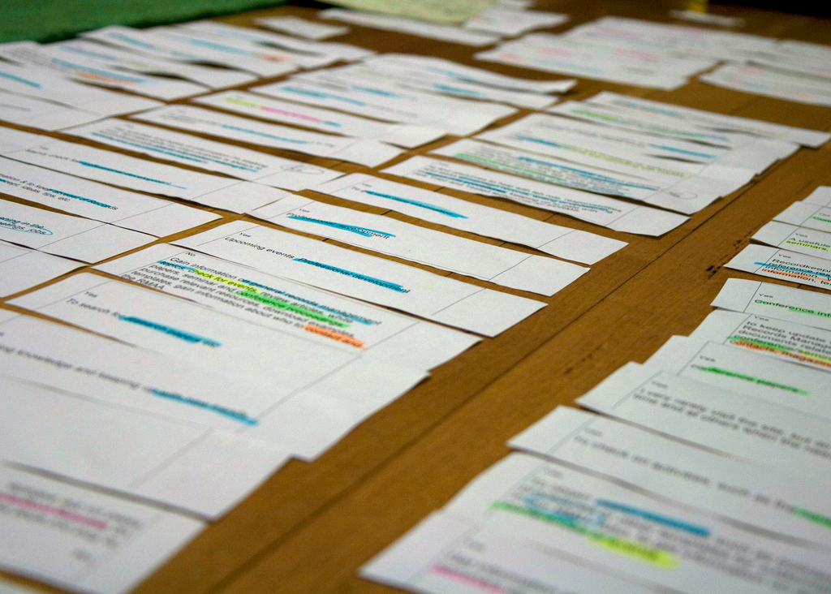
Solution: User Stories (USs)
“... a chunk of functionality (some people use the
word feature) that is of value to the customer.”
http://flic.kr/p/884GBP
Source: Kent Beck & Martin Fowler, Planning Extreme Programming

Slide 11
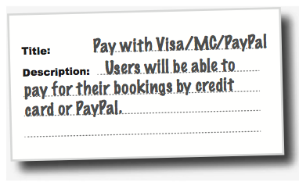
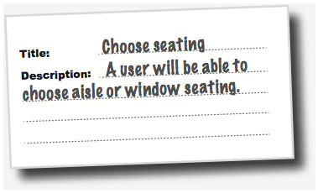
Flight-Booking System Example
Two parts: title and description

Slide 12
US Description Template
As a <who>, I want <what> so that <why>.
Examples
As a user, I want to backup my entire hard drive so that I won't lose data if my system breaks.
As an Editor, I want to review content before it is published so that I can assure it is optimized with correct grammar and tone.
As a Content Owner, I want to be able to create product content so that I can provide information and market to customers.

Slide 13
Description Examples: Who and What

Slide 14
US Title Template: Verb + Noun

Slide 15
User Story Dos & Don’ts
Do... | Don't...
Describe one thing that the software needs to do for the customer | Include what essentially amount to groups of features (even if all are related)
Use language that the customer understands | Use technical terms that are unfamiliar to the customer
Ensure "written by the customer" (at least figuratively speaking) | Invent requirements that the customer never actually asked for
Keep short – generally no more than three sentences | Write a long essay
Capture only requirements (not design) | Mention specific implementation technologies or user-interface elements
Principle: Keep requirements customer-oriented
Note: USs are for functional requirements only

Slide 16
Summary
Requirements definition and types
User stories
US title and description templates
Qualities of good USs
http://flic.kr/p/aCLor3

