Slide 1
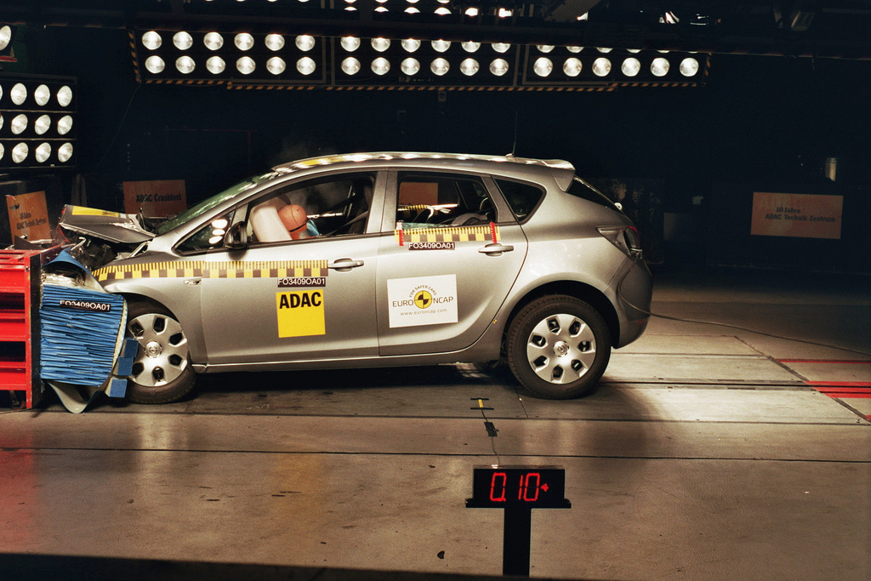
http://flic.kr/p/7iffKj
Software Testing: Statement Coverage

Slide 2
The Testing Problem
How to choose set of test cases that reveals all errors?
Fundamental research problem
Essentially unsolvable in general case
Exhaustive testing of all input combinations not possible

Slide 3
Two common ways to choose test cases
Black-box testing
White-box testing

Slide 4
Black-Box Testing
Choose based on module’s possible inputs and outputs—i.e., its interface
Do not use internal code
Often test boundary cases
Example: Values at 0, 1, and -1 (around the zero boundary)
Our model tests so far have been black box

Slide 5
White-Box Testing (aka glass box testing, clear box testing)
Uses internal logic to choose tests
Different levels of code coverage
Degree to which code is tested by a test suite

Slide 6
Statement Coverage
Set of test cases such that each program statement is executed at least once

Slide 7
Coverage Support Tools
SimpleCov Ruby Gem

Slide 8
Coverage Support Tools
SimpleCov Ruby Gem

Slide 9
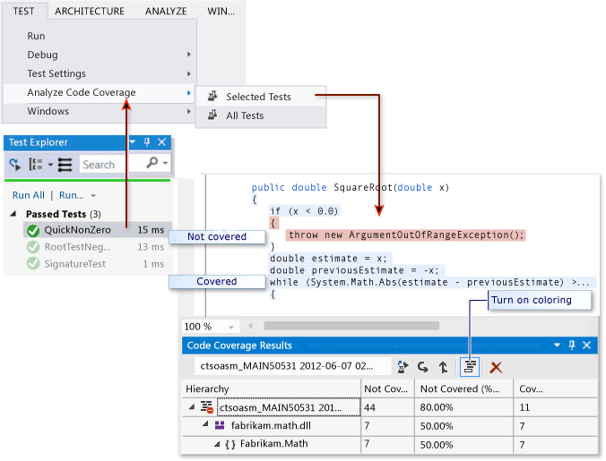
Coverage Support Tools
Visual Studio
https://msdn.microsoft.com/en-us/library/dd537628.aspx

Slide 10
Summary
The testing problem
Black-box testing and boundary conditions
White-box testing and code coverage
Statement coverage
http://flic.kr/p/aCLor3

