Slide 1
http://flic.kr/p/7u4Xr2
Software Engineering Process & Planning

Slide 2
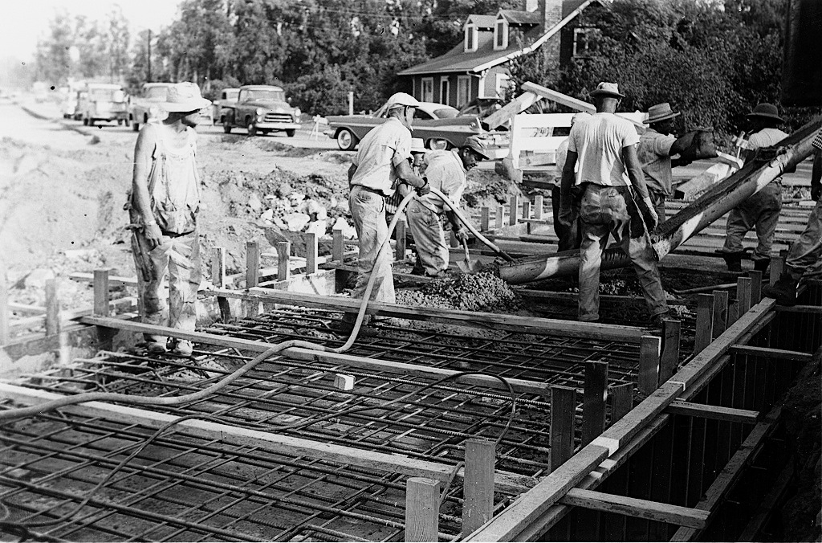
Engineering software is a big job
http://flic.kr/p/7GereG
http://flic.kr/p/5w9rXP
Many types of tasks:
Requirements
Design
Implementation
Verification (testing)

Slide 3
Practical issue: What order should tasks be done in?
That is, what process to use?

Slide 4
The classic way: Waterfall (sequential) model
Requirements
But often a bad way…
Design
Implementation
Verification
Maintenance
http://en.wikipedia.org/wiki/File:Waterfall_model_%281%29.svg
Notes:
60s and 70s-era advice

Slide 5
What could go wrong?
Requirements
6 months
Design
6 months
Implementation
3 months
Verification
6 months
Release!
http://en.wikipedia.org/wiki/File:Waterfall_model_%281%29.svg

Slide 6
What could go wrong?
Problem!
Requirements
6 months
Design
6 months
Implementation
I don’t like it…
3 months
Verification
6 months
Release!
Customer
http://en.wikipedia.org/wiki/File:Waterfall_model_%281%29.svg
Notes:
60s and 70s-era advice

Slide 7
Why Waterfall doesn’t work
False assumption: Specifications are …
predictable – can be correctly defined at the start
stable – have low change rates
Actual stats:
25% of requirements changed
35% to 50% changed in large projects

Slide 8
Solution: Empirical Process Model
Feedback
Adaptation

Slide 9
Iterative Development Process
Requirements
Analysis
Design
Initial Planning
Planning
Implementation
Testing
Evaluation
Deployment

Slide 10
Iterative Development Process
Requirements
Analysis
Design
Initial Planning
Planning
Implementation
Where are
feedback
&
adaptation?
Testing
Evaluation
Deployment

Slide 11
Iterative Development Process
Requirements
Analysis
Design
Initial Planning
Planning
Implementation
Adaptation
Feedback
Testing
Evaluation
Deployment

Slide 12
Key Benefits of Iterative Development
Early mitigation of risk
Early visible progress (no “analysis paralysis”)
Fail fast, catch changing requirements quickly
Iterative process improvement

Slide 13
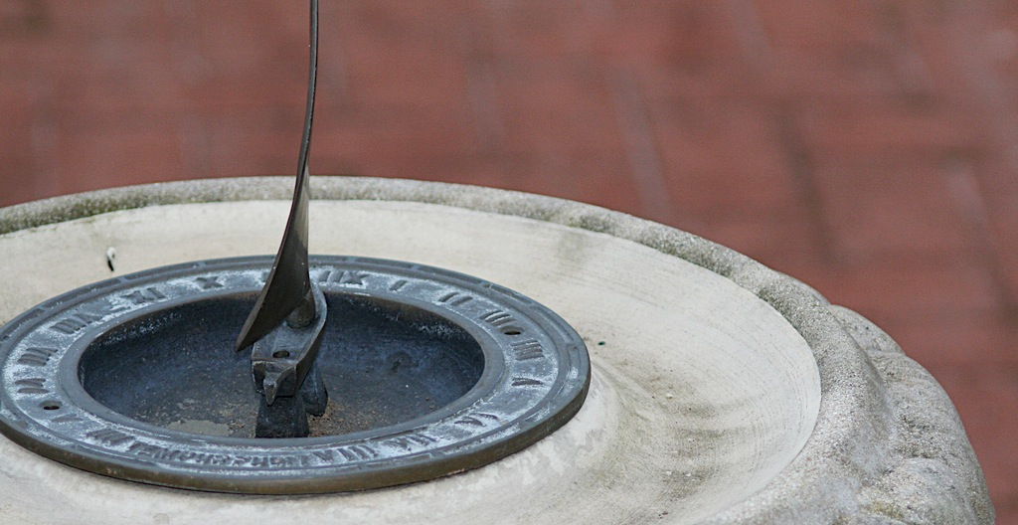
How long should iterations be?
Short is good
2 to 6 weeks
1 is too short to get meaningful feedback
Long iterations subvert the core motivation
http://flic.kr/p/368zW7

Slide 14
Iterative Development Process
We are here – how to proceed?
Analysis
Design
Implementation
Requirements
Planning
Initial Planning
Testing
Evaluation
Deployment

Slide 15
Developer
Customer
Requirements
Create USs
Estimate USs
USs + Estimates
Prioritize USs
USs + Estimates + Priorities
Choose USs for Iteration
Divide Chosen USs into Tasks
Assign Tasks to Workers
Get to Work!

Slide 16
Developer
Customer
Requirements
Create USs
Estimate USs
USs + Estimates
Prioritize USs
USs + Estimates + Priorities
Choose USs for Iteration
Divide Chosen USs into Tasks
Assign Tasks to Workers
Get to Work!

Slide 17
Estimation is Hard
http://xkcd.com/1658/

Slide 18
Principles for Estimation
Principle: Estimates for smaller, more-immediate tasks tend to be more accurate than ones for larger, more-future tasks
Principle: Past performance is the best indicator of future performance
Approach: Track your outcomes; refine your estimates
Principle: Wisdom of the crowd
Goal: Predict how events will unfold
Think event planning
Problem: Easy to miss something
Solution: More brains = more opportunities to catch eventualities

Slide 19
Planning Poker Estimation using Wisdom of the Crowd
Cards with days of work
For each US:
Discuss work involved
Flip cards
Repeat until consensus
Efficiency in estimating is important
Don’t expect your estimates to be super accurate

Slide 20
Here’s a video demonstration of planning poker:
http://youtu.be/0FbnCWWg_NY
Here’s a planning poker web app:
https://planningpokeronline.com/

Slide 21
Developer
Customer
Requirements
Create USs
Estimate USs
USs + Estimates
Prioritize USs
USs + Estimates + Priorities
Choose USs for Iteration
Divide Chosen USs into Tasks
Assign Tasks to Workers
Get to Work!

Slide 22
Principle: Customer sets priorities
Ensures alignment with customer goals
Helps customer feel in control
Project isn’t going “off the rails”
Estimates help customer maximize cost-benefit

Slide 23
Priority Numbering Scheme
Multiples of 10:
10 - Highest priority
20
30
40
50
… - Lowest priority
Non-multiples of 10 may be used if helpful

Slide 24
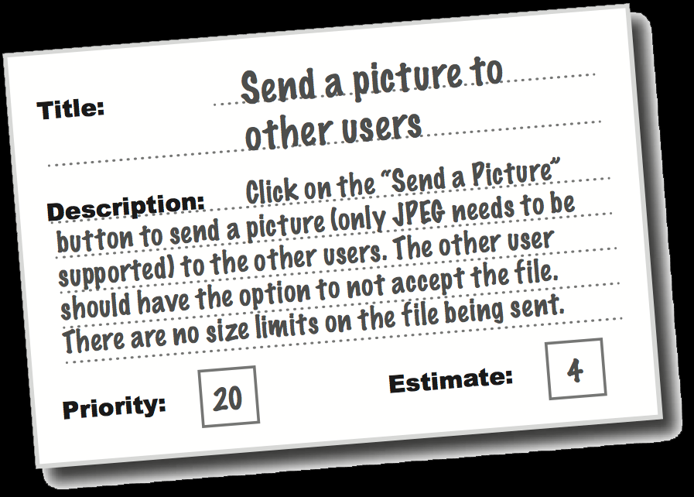
So in the end you have…
Collection of user stories
With estimates
And customer priorities
Now you can plan the next iteration!

Slide 25
Summary
Software Engineering Process
Waterfall Process Model
Empirical Process Model
Customer-Centered Iterative and Incremental Development Process
Estimation (Planning Poker)
Prioritization (numbering scheme)
http://flic.kr/p/aCLor3

