Slide 1
https://flic.kr/p/dxGXD
MVC Model Associations
Notes:
Painted Shadows - Not Allowed
Taken from Alexander Calder's mobile room at the National Gallery of Art, Washington DC.

Slide 2
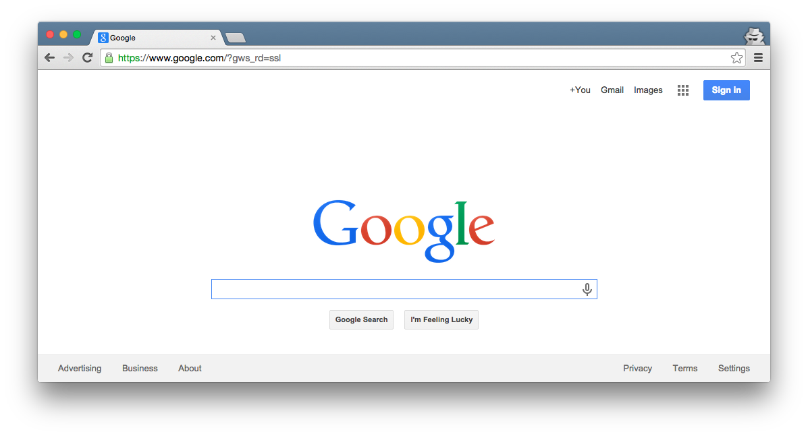
Browser
Migrations
Ye Olde Internet
Tests
DB
Server
View
Router
Controller
Model

Slide 3
Browser
Migrations
Ye Olde Internet
Tests
DB
Server
View
Router
Controller
Model

Slide 4
MVC Model Review
Browser
What key capabilities do Rails model classes provide?
Ye Olde Internet
DB
Server
View
Router
Controller
Model

Slide 5
MVC Model Review
Browser
What key capability do Rails model classes provide?
CRUD persistent data
Ye Olde Internet
DB
Server
View
Router
Controller
Model

Slide 6
MVC Model Review
Browser
How do you create Rails model classes?
Ye Olde Internet
DB
Server
View
Router
Controller
Model

Slide 7
MVC Model Review
Browser
How do you create Rails model classes?
Generate DB migrations and model classes with “rails g model …” then customize
Ye Olde Internet
DB
Server
View
Router
Controller
Model

Slide 8
MVC Model Review
Browser
What purpose do migrations serve?
Ye Olde Internet
DB
Server
View
Router
Controller
Model

Slide 9
MVC Model Review
Browser
What purpose do migrations serve?
Setup tables in DB via, e.g., “rails db:migrate” command
Ye Olde Internet
DB
Server
View
Router
Controller
Model

Slide 10
MVC Model Review
What DB table would go with this model class?
Model Class:
Database Table:
Author
???
first_name : string
last_name : string
year : integer

Slide 11
MVC Model Review
What DB table would go with this model class?
Model Class:
Database Table:
authors
Author
id | first_name | last_name | year
1 | Ayn | Rand | 1905
2 | Peter | Benchley | 1940
first_name : string
last_name : string
year : integer

Slide 12
MVC Model Review
What DB table would go with this model class?
Model Class:
Database Table:
authors
Author
id | first_name | last_name | year
1 | Ayn | Rand | 1905
2 | Peter | Benchley | 1940
first_name : string
last_name : string
year : integer
Recall Rails ORM (Object-Relational Mapping)

Slide 13
MVC Model Review
What Author methods does Rails provide “for free”?
Model Class:
Author
first_name : string
last_name : string
year : integer

Slide 14
MVC Model Review
What Author methods does Rails provide “for free”?
Model Class:
Many methods:
Author.create / Author.create!
Author.find
Author.find_by
Author.all
Getters/Setters for attributes:
Author#first_name
Author#first_name=
Author#save / Author#save!
Author#destroy
Author#valid?
Author
first_name : string
last_name : string
year : integer

Slide 15
Limitation so far: Insular model classes/tables
Model Class:
Database Table:
authors
Author
id | first_name | last_name | year
1 | Ayn | Rand | 1905
2 | Peter | Benchley | 1940
first_name : string
last_name : string
year : integer

Slide 16
Imagine an author-profile class
Model Class:
Database Table:
authors
Author
id | first_name | last_name | year
1 | Ayn | Rand | 1905
2 | Peter | Benchley | 1940
first_name : string
last_name : string
year : integer
AuthorProfile
author_profiles
birthplace : string
bio : text
awards : text
id | birthplace | bio | awards
23 | Saint Petersburg | Rand was born… | Prometheus Award, …
42 | New York City | He was the son of… | Shark Conservation, …

Slide 17
What if you want inter-class relationships?
Author
???
AuthorProfile
first_name : string
last_name : string
year : integer
birthplace : string
bio : text
awards : text
For example, you might want to say:

Slide 18
Rails Model Associations
Topics:
OO Class Associations
Rails ORM
How to code in Rails

Slide 19
Rails Model Supports Three Associations
1
has ▶︎
1
one to one
(has one / belongs to one)
A
B
1
has ▶
*
one to many
(has many / belongs to one)
A
B
*
*
many to many
(join table)
A
B
AB

Slide 20
Class Association Notation
Author
AuthorProfile
1
author
has
1
profile
first_name : string
last_name : string
year : integer
birthplace : string
bio : text
awards : text

Slide 21
Class Association Notation
Author
AuthorProfile
1
author
has
1
profile
first_name : string
last_name : string
year : integer
birthplace : string
bio : text
awards : text
Class Association

Slide 22
Class Association Notation
Author
AuthorProfile
1
author
has
1
profile
first_name : string
last_name : string
year : integer
birthplace : string
bio : text
awards : text
Association Name Triangle indicates reading direction (i.e., Author has AuthorProfile)

Slide 23
Class Association Notation
Author
AuthorProfile
1
author
has
1
profile
first_name : string
last_name : string
year : integer
birthplace : string
bio : text
awards : text
Role Names
Like attribute/method name
Enables this method call:
@author.profile.birthplace

Slide 24
Class Association Notation
Author
AuthorProfile
1
author
has
1
profile
first_name : string
last_name : string
year : integer
birthplace : string
bio : text
awards : text
Multiplicities

Slide 25
Class Association Notation
Author
AuthorProfile
1
author
has
1
profile
first_name : string
last_name : string
year : integer
birthplace : string
bio : text
awards : text
Multiplicities
Each Author has 1 AuthorProfile

Slide 26
Class Association Notation
Author
AuthorProfile
1
author
has
1
profile
first_name : string
last_name : string
year : integer
birthplace : string
bio : text
awards : text
Multiplicities
Each Author has 1 AuthorProfile
Each AuthorProfile belongs to 1 Author

Slide 27
Class Association Notation
Author
AuthorProfile
1
author
has
1
profile
first_name : string
last_name : string
year : integer
birthplace : string
bio : text
awards : text
Multiplicities
Each Author has 1 AuthorProfile
Each AuthorProfile belongs to 1 Author
Zero-or-More Multiplicities:
A
has
*
B
Each A has 0 or more Bs
A
has
0..*
B
Each A has 0 or more Bs

Slide 28
Class Association Notation
Author
AuthorProfile
1
author
has
1
profile
first_name : string
last_name : string
year : integer
birthplace : string
bio : text
awards : text
Associations manifest as links in object diagrams
: Author
: AuthorProfile
first_name = "Ayn"
last_name = "Rand"
year_born = 1905
author
profile
birthplace = "Saint Petersburg"
bio = "Rand was born..."
awards = "Prometheus Award, …"
: Author
: AuthorProfile
first_name = "Peter"
last_name = "Benchley"
year_born = 1940
author
profile
birthplace = "New York City"
bio = "He was the son of..."
awards = " Shark Conservation, … "

Slide 29
Class Association Notation
Physician
Patient
*
physician
*
patient
name : string
name : string
Appointment
appointment_date : datetime
Association Class
Each instance is an association link
Can add additional data to each link (e.g., date)

Slide 30
Class Association Notation
Physician
Patient
*
physician
*
patient
name : string
name : string
Appointment
appointment_date : datetime
Enables code like this:

Slide 31
Class Association Notation
Physician
Patient
*
physician
*
patient
name : string
name : string
Appointment
appointment_date : datetime
How many-to-many links look in object diagrams:
: Appointment
: Patient
appointment_date = ...
name = "Homer Simpson"
patient
: Physician
physician
name = "Dr. Hibbert"
physician
patient
: Appointment
: Patient
appointment_date = ...
name = "Marge Simpson"

Slide 32
Rails Model Associations
Topics:
OO Class Associations
Rails ORM
How to code in Rails

Slide 33
To map this association to relational DB...
Author
AuthorProfile
1
author
has
1
profile
first_name : string
last_name : string
year : integer
birthplace : string
bio : text
awards : text
: Author
: AuthorProfile
first_name = "Ayn"
last_name = "Rand"
year_born = 1905
author
profile
birthplace = "Saint Petersburg"
bio = "Rand was born..."
awards = "Prometheus Award, …"
: Author
: AuthorProfile
first_name = "Peter"
last_name = "Benchley"
year_born = 1940
author
profile
birthplace = "New York City"
bio = "He was the son of..."
awards = " Shark Conservation, … "

Slide 34
Requires inter-table references
authors
id | first_name | last_name | year
1 | Ayn | Rand | 1905
2 | Peter | Benchley | 1940
author_profiles
id | birthplace | bio | awards
23 | Saint Petersburg | Rand was born… | Prometheus Award, …
42 | New York City | He was the son of… | Shark Conservation, …

Slide 35
Rails ORM Varies by Type of Association
1
has ▶︎
1
one to one
(has one / belongs to one)
A
B
1
has ▶
*
one to many
(has many / belongs to one)
A
B
*
*
many to many
(join table)
A
B
AB

Slide 36
Has One / Belongs To One Example
Author
AuthorProfile
1
author
has
1
profile
first_name : string
last_name : string
year : integer
birthplace : string
bio : text
awards : text
Rails ORM DB Tables
authors
id | first_name | last_name | year
1 | Ayn | Rand | 1905
2 | Peter | Benchley | 1940
author_profiles
id | author _id | birthplace | bio | awards
23 | 1 | Saint Petersburg | Rand was born… | Prometheus Award, …
42 | 2 | New York City | He was the son of… | Shark Conservation, …

Slide 37
Has One / Belongs To One Example
Author
AuthorProfile
1
author
has
1
profile
first_name : string
last_name : string
year : integer
birthplace : string
bio : text
awards : text
Rails ORM DB Tables
authors
id | first_name | last_name | year
1 | Ayn | Rand | 1905
2 | Peter | Benchley | 1940
references
author_profiles
id | author _id | birthplace | bio | awards
23 | 1 | Saint Petersburg | Rand was born… | Prometheus Award, …
42 | 2 | New York City | He was the son of… | Shark Conservation, …

Slide 38
Primary versus Foreign Keys
Primary Key: Uniquely identifies each record in table
authors
id | first_name | last_name | year
1 | Ayn | Rand | 1905
2 | Peter | Benchley | 1940
author_profiles
id | author _id | birthplace | bio | awards
23 | 1 | Saint Petersburg | Rand was born… | Prometheus Award, …
42 | 2 | New York City | He was the son of… | Shark Conservation, …

Slide 39
Primary versus Foreign Keys
Primary Key: Uniquely identifies each record in table
Foreign Key: Reference to primary key in another table
authors
id | first_name | last_name | year
1 | Ayn | Rand | 1905
2 | Peter | Benchley | 1940
author_profiles
id | author _id | birthplace | bio | awards
23 | 1 | Saint Petersburg | Rand was born… | Prometheus Award, …
42 | 2 | New York City | He was the son of… | Shark Conservation, …

Slide 40
Primary versus Foreign Keys
Primary Key: Uniquely identifies each record in table
Foreign Key: Reference to primary key in another table
authors
id | first_name | last_name | year
1 | Ayn | Rand | 1905
2 | Peter | Benchley | 1940
author_profiles
id | author _id | birthplace | bio | awards
23 | 1 | Saint Petersburg | Rand was born… | Prometheus Award, …
42 | 2 | New York City | He was the son of… | Shark Conservation, …

Slide 41
How to Set Up Association in Rails
Generate migration that adds reference (foreign key) column to appropriate table
Add has_one/belongs_to declarations to model class
See forthcoming demo for details

Slide 42
Rails Relationship Support
has one / belongs to one
has many / belongs to one
join table

Slide 43
Has Many / Belongs to One Example
Author
AuthorProfile
1
author
has
1
profile
first_name : string
last_name : string
year : integer
birthplace : string
bio : text
awards : text
Book
How to model authorship? (assume 1 author per book)
title : string
year : integer
summary : text

Slide 44
Has Many / Belongs to One Example
Author
AuthorProfile
1
author
has
1
profile
first_name : string
last_name : string
year : integer
birthplace : string
bio : text
awards : text
1 author
has
* book
Book
How to model authorship? (assume 1 author per book)
title : string
year : integer
summary : text

Slide 45
Has Many / Belongs to One Example
What should the ORM be?
(hint: authors table unchanged)
Author
first_name : string
last_name : string
year : integer
authors
1 author
id | first_name | last_name | year
1 | Ayn | Rand | 1905
2 | Peter | Benchley | 1940
has
* book
Book
title : string
year : integer
summary : text

Slide 46
Has Many / Belongs to One Example
What should the ORM be?
(hint: authors table unchanged)
Author
first_name : string
last_name : string
year : integer
authors
1 author
id | first_name | last_name | year
1 | Ayn | Rand | 1905
2 | Peter | Benchley | 1940
has
* book
Book
title : string
year : integer
summary : text
books
id | title | year | summary | author_id
72 | The Fountainhead | 1943 | Individualistic architect… | 1
98 | Atlas Shrugged | 1957 | Dystopian USA… | 1
99 | Jaws | 1974 | Shark!... | 2

Slide 47
Has Many / Belongs to One Example
What should the ORM be?
(hint: authors table unchanged)
Author
first_name : string
last_name : string
year : integer
authors
1 author
id | first_name | last_name | year
1 | Ayn | Rand | 1905
2 | Peter | Benchley | 1940
has
* book
Book
title : string
year : integer
summary : text
books
id | title | year | summary | author_id
72 | The Fountainhead | 1943 | Individualistic architect… | 1
98 | Atlas Shrugged | 1957 | Dystopian USA… | 1
99 | Jaws | 1974 | Shark!... | 2

Slide 48
Has Many / Belongs to One Example
Rails generates books method that returns list of books
Author
first_name : string
last_name : string
year : integer
authors
1 author
id | first_name | last_name | year
1 | Ayn | Rand | 1905
2 | Peter | Benchley | 1940
has
* book
Book
title : string
year : integer
summary : text
books
id | title | year | summary | author_id
72 | The Fountainhead | 1943 | Individualistic architect… | 1
98 | Atlas Shrugged | 1957 | Dystopian USA… | 1
99 | Jaws | 1974 | Shark!... | 2

Slide 49
How to Set Up in Rails
Essentially the same as has_one
Again, see the demo

Slide 50
Rails Relationship Support
has one / belongs to one
has many / belongs to one
join table

Slide 51
Example Many-to-Many Association
Physician
Patient
*
physician
*
patient
name : string
name : string
Appointment
appointment_date : datetime

Slide 52
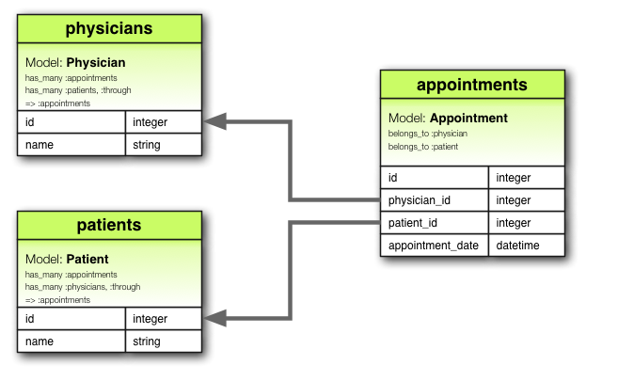
Join Table Example
From http://guides.rubyonrails.org/v4.2.0/association_basics.html

Slide 53
Join Table Example
Join table
From http://guides.rubyonrails.org/v4.2.0/association_basics.html

Slide 54
Join Table Example
References (aka foreign keys)
From http://guides.rubyonrails.org/v4.2.0/association_basics.html

Slide 55
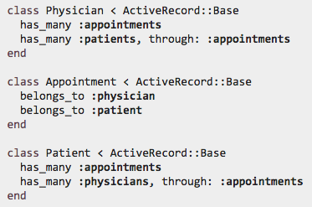
Join Table Example: Model Class
through enables this sort of thing:
From http://guides.rubyonrails.org/v4.2.0/association_basics.html

Slide 56
How to Set Up in Rails
See the Model Association demos
For more info:
http://guides.rubyonrails.org/v6.1.0/association_basics.html
http://api.rubyonrails.org/v6.1.0/classes/ActiveRecord/Associations/ClassMethods.html

Slide 57
Summary
Model associations
Foreign keys
Rails ORM for assoc.
Has-one/belong-to-one
Has-many/belongs-to-one
Many-to-many join table
http://flic.kr/p/aCLor3

Slide 58
Appendix

Slide 59
Browser
Migrations
Ye Olde Internet
Tests
DB
Server
View
Router
Controller
Model

Slide 60
Has One / Belongs To One Example
Author
AuthorProfile
1
author
has
1
profile
first_name : string
last_name : string
year : integer
birthplace : string
bio : text
awards : text
Associated DB Tables
authors
id | first_name | last_name | year
1 | Ayn | Rand | 1905
2 | Peter | Benchley | 1940
references
author_profiles
id | author _id | birthplace | bio | awards
23 | 1 | Saint Petersburg | Rand was born… | Prometheus Award, …
42 | 2 | New York City | He was the son of… | Shark Conservation, …

Slide 61
Has Many / Belongs to One Example
Author
first_name : string
last_name : string
year : integer
authors
1 author
id | first_name | last_name | year
1 | Ayn | Rand | 1905
2 | Peter | Benchley | 1940
has
* book
references
Book
title : string
year : integer
summary : text
books
id | title | year | summary | author_id
72 | The Fountainhead | 1943 | Individualistic architect… | 1
98 | Atlas Shrugged | 1957 | Dystopian USA… | 1
99 | Jaws | 1974 | Shark!... | 2

Slide 62
Has Many / Belongs to One Example
Author
first_name : string
last_name : string
year : integer
authors
1 creator
id | first_name | last_name | year
1 | Ayn | Rand | 1905
2 | Peter | Benchley | 1940
has
* creation
references
Book
title : string
year : integer
summary : text
books
id | title | year | summary | author_id
72 | The Fountainhead | 1943 | Individualistic architect… | 1
98 | Atlas Shrugged | 1957 | Dystopian USA… | 1
99 | Jaws | 1974 | Shark!... | 2

Slide 63
Author
first_name : string
last_name : string
year : integer
1 author
has
* book
Book
Publisher
title : string
year : integer
summary : text
*
title
has
1
imprint
name : string
url: string

Slide 64
Author
AuthorProfile
1
author
has
1
profile
first_name : string
last_name : string
year : integer
birthplace : string
bio : text
awards : text
1 author
has
* book
Book
Publisher
title : string
year : integer
summary : text
*
title
has
1
imprint
name : string
url: string

