Slide 1
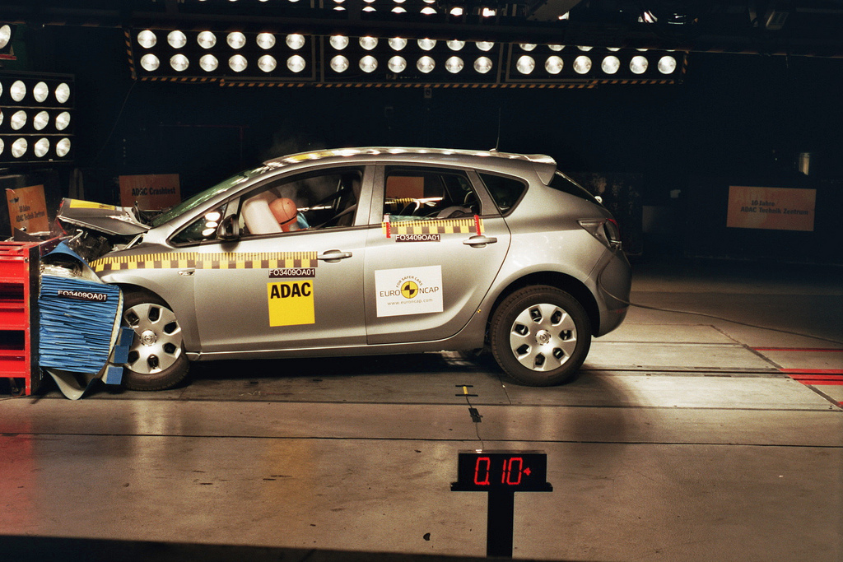
Software Testing
http://flic.kr/p/7iffKj

Slide 2
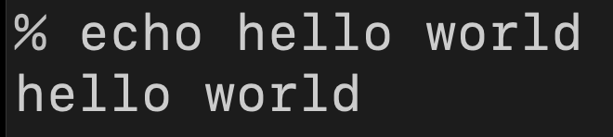
How to Exhaustively Test the echo Command?

Slide 3
How to Exhaustively Test the echo Command?
Answer:
Make a test for every possible input
If all tests pass, program is 100% error free

Slide 4
How to Exhaustively Test the echo Command?
How many tests would that be?
Simplifying Assumption: ≤ 10-character argument
Each character an 8-bit byte
8-bit byte has 2⁸ = 256 possible values
256¹⁰ + 256⁹ + 256⁸ + … + 256¹ ≥ 10²⁴ tests

Slide 5
How to Exhaustively Test the echo Command?
How long would it take to run 10²⁴ tests?
At 1,000 tests per second, takes ≥ 10¹³ years! 😱
Clearly exhaustive testing isn’t practical

Slide 6
The Testing Problem
How to choose set of test cases that reveals all errors?
Fundamental research problem
Essentially unsolvable in general case

Slide 7
Two common ways to choose test cases
Black-box testing
White-box testing

Slide 8
Black-Box Testing
Choose tests based on module’s interface
  That is, its possible inputs and outputs
  Do not use internal code
Test happy path cases
  “Typical” use case with no errors or weirdness
Test boundary cases / edge cases / corner cases
  Input values around min/max of allowable range, including error values just beyond min/max

Slide 9
Boundary Case Examples
Date cannot be after today
  Test date for yesterday, today, and tomorrow
String cannot be longer than 32 characters
  Test strings with 31, 32, and 33 characters
String cannot be “blank”
  Test strings that are nil, empty (“”), and 1 character long
Monetary value (stored as integer)
  Test -1, 0, and +1

Slide 10
White-Box Testing
(aka glass box testing, clear box testing)
Use internal logic to choose tests
Different levels of code coverage
  Degree to which code is tested by a test suite

Slide 11
Statement Coverage
Set of test cases such that each program statement is executed at least once

Slide 12
Branch Coverage
Set of test cases such that each boolean expression (in control structures) evaluates to true at least once and to false at least once
def is_it_xmas?(month, day)
if month == 12 && day == 25
return true
else
return false
end
end
if month == 12 && day == 25
return true
else
return false
✓
true
false
✓

Slide 13
Coverage Support Tools
SimpleCov Ruby Gem

Slide 14
Coverage Support Tools
SimpleCov Ruby Gem

Slide 15
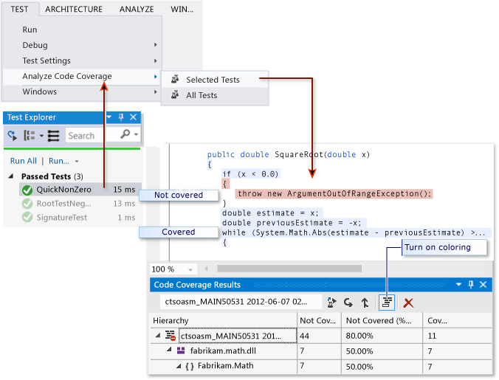
Coverage Support Tools
Visual Studio
https://msdn.microsoft.com/en-us/library/dd537628.aspx

Slide 16

Summary
Impracticality of exhaustive testing
The testing problem
Black-box testing and boundary conditions
White-box testing and code coverage
Statement coverage
http://flic.kr/p/aCLor3

