Slide 1
Rails and MVC
“rails” by Devlon Duthie is licensed under CC BY-NC 2.0 / Cropped from original
Notes:
“rails” by Devlon Duthie is licensed under CC BY-NC 2.0 / Cropped from original
https://www.flickr.com/photos/devlon/24128170490/

Slide 2
In order to code in Rails, you must know the Rails Architecture like the back of your 🤚

Slide 3
Let’s Draw a Dataflow Diagram of It!
Boxes are software components
Directed edges show how data is passed between components
Component 1
Component 2

Slide 5
Web Server
Browser
Ye Olde Internet

Slide 6
Web Server
Browser
Ye Olde Internet

Slide 7
Web Server
Browser
HTTP requests and responses
Ye Olde Internet

Slide 8
Web Server
Browser
Ye Olde Internet
DBMS

Slide 9
Web Server
Browser
Ye Olde Internet
DBMS

Slide 10
Web Server
Browser
Ye Olde Internet
Router
DBMS

Slide 11
Web Server
Browser
Ye Olde Internet
Router
Controller
DBMS

Slide 12
Web Server
Browser
Ye Olde Internet
Router
Controller
Model
DBMS

Slide 13
Web Server
Browser
Ye Olde Internet
Router
Controller
Model
DBMS

Slide 14
Web Server
Browser
View
Ye Olde Internet
Router
Controller
Model
DBMS

Slide 15
Web Server
Browser
View
Ye Olde Internet
Router
Controller
Model
DBMS

Slide 16
Web Server
Browser
View
Ye Olde Internet
Router
Controller
These are the “big 4” you must know really well!
Model
DBMS

Slide 17
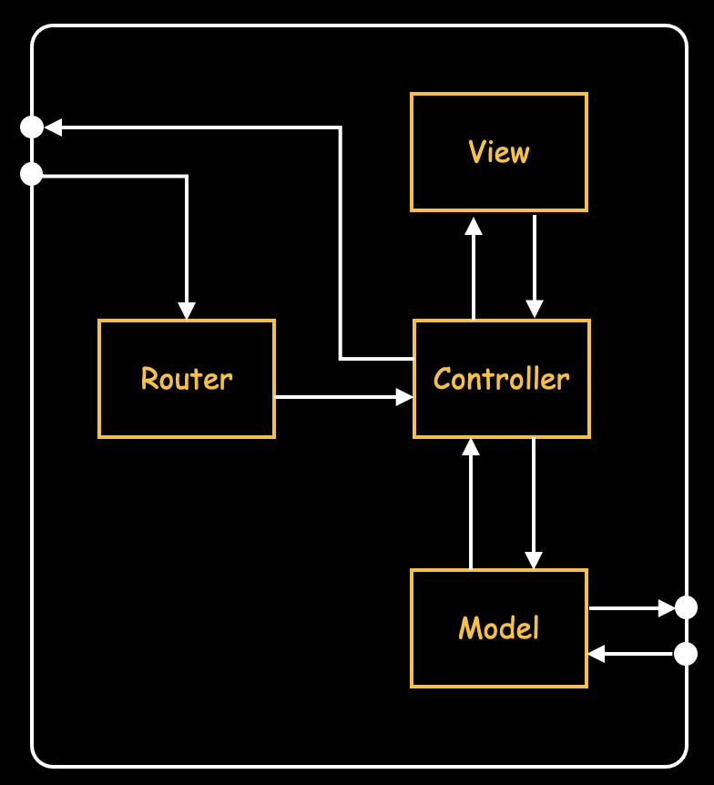
Rails Component Responsibilities
Model | “Business” logic, data management
View | User-Interface (UI) appearance, HTML generation
Controller | Translates UI actions (HTTP requests) into operations on model and view
Router | Translates HTTP request into call to controller method

Slide 18
Web Server
Browser
View
Ye Olde Internet
Router
Controller
Making an app primarily involves adding custom code to each of these components
Model
DBMS

Slide 19
Rails Component File Types
Model | Multiple Ruby classes
View | Multiple HTML.ERB files (HTML with embedded Ruby)
Controller | Multiple Ruby classes
Router | Exactly one Ruby block
We don’t create the model classes and the controller classes by hand
We generate them with rails generate …

Slide 20
Rails Project Directory Organization
├── app
│ ├── assets
│ ├── channels
│ ├── controllers
│ ├── helpers
│ ├── javascript
│ ├── jobs
│ ├── mailers
│ ├── models
│ └── views
├── bin
├── config
├── db
├── lib
├── log
├── public
├── storage
├── test
├── tmp
└── vendor
← Images and CSS
← Controller classes (****_controller.rb)
← Model classes (****.rb)
← HTML.ERB view templates (****/****.html.erb)
← Routes block (in routes.rb)
← Database seeds, schema, and migrations (related to models)

Slide 21
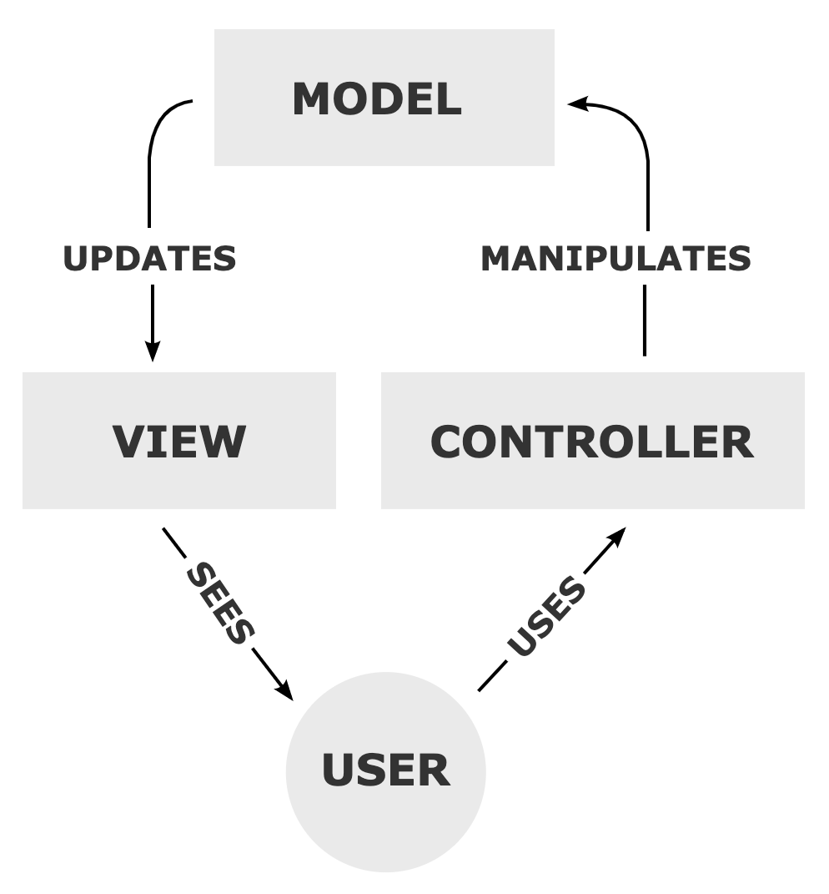
Model–View–Controller (MVC)
Widely used architectural pattern
Good for any app with UI (e.g., desktop, mobile, and web apps)
Rails adds Router component, which may be considered part of Controller
“MVC-Process” by RegisFrey is released into the public domain by the copyright holder

Slide 22
Summary
Rails architecture – know it like the back of your 🤚!
4 main Rails components
What files make them up
Where to find them
Model–View–Controller (MVC) architectural pattern

