Slide 1
http://flic.kr/p/ar4nLn
Databases and the MVC Model

Slide 2
How do we enable our Rails apps to CRUD persistent data?
The Big Question
Create, Read, Update, Delete

Slide 3
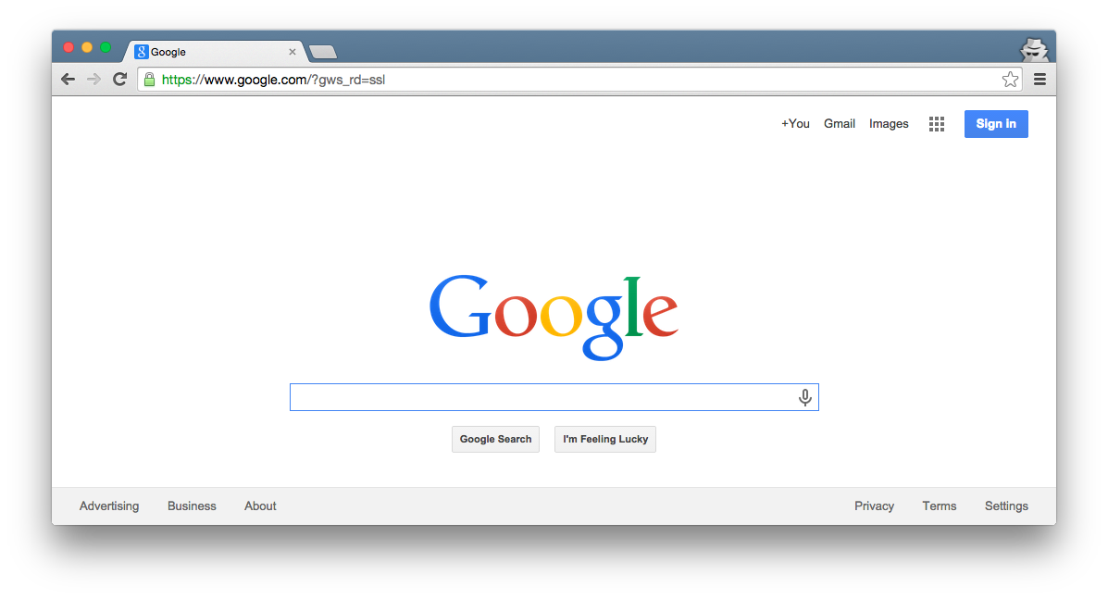
Browser
Migrations
Ye Olde Internet
DB
Server
View
Router
Controller
Model

Slide 4
Browser
Today’s focus
Migrations
Ye Olde Internet
DB
Server
View
Router
Controller
Model

Slide 5
Browser
Migrations
Rails uses a DBMS
Ye Olde Internet
DB
Server
View
Router
Controller
Model

Slide 6
Database (DB): Organized collection of data
Database Management System (DBMS): Controls the creation, maintenance, and use of a DB
Examples:
PostgreSQL

Slide 7
Browser
Migrations
Migrations set up the database
Ye Olde Internet
Model classes use the database
DB
Server
View
Router
Controller
Model

Slide 8
Outline
Migrations
DBs and DBMSs
Rails Object–Relational Mapping
DB
Model

Slide 9
Outline
Migrations
DBs and DBMSs
Rails Object–Relational Mapping
DB
Model

Slide 10
Two key aspects of a DBMS
Database model: How DB is structured and used
Examples: Relational, Object-Oriented, Hierarchical
Query language: Types of questions you can ask
Examples: SQL, XQuery
Relational model + SQL is most common
and used by Rails

Slide 11
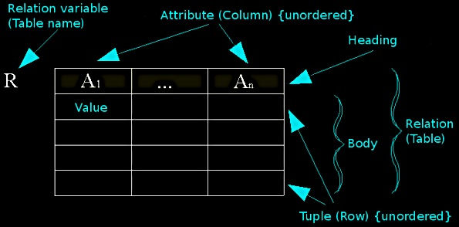
Relational Model Concepts
http://en.wikipedia.org/wiki/File:Relational_model_concepts.png

Slide 12
Example Tables
authors
id | first_name | last_name | year_born
1 | Ayn | Rand | 1905
2 | Peter | Benchley | 1940
publishers
id | publisher_name
1 | Bobbs Merrill
2 | Random House

Slide 13
How Apps Use DBs
Pre-deployment of app:
Create (empty) tables
Rails migrations do this
Maybe “seed” with data
At runtime of app:
CRUD table rows
Rails model classes do this
NOTE: Tables/columns don’t change

Slide 14
CRUD-to-SQL Mapping
CRUD Operation | SQL Statement
Create | INSERT
Read (Retrieve) | SELECT
Update (Modify) | UPDATE
Delete (Destroy) | DELETE
For complete MySQL documentation, see: http://dev.mysql.com/doc/refman/5.5/en/sql-syntax-data-manipulation.html

Slide 15
Example SELECT Queries
authors
id | first_name | last_name | year_born
1 | Ayn | Rand | 1905
2 | Peter | Benchley | 1940
SELECT * FROM authors
SELECT * FROM authors WHERE year_born > 1910
SELECT * FROM authors WHERE last_name REGEXP '[a-r]*'
SELECT * FROM authors WHERE last_name REGEXP '[a-r]*' ORDER BY last_name ASC
For complete MySQL documentation, see http://dev.mysql.com/doc/refman/5.5/en/select.html, http://dev.mysql.com/doc/refman/5.5/en/pattern-matching.html

Slide 16
Outline
Migrations
DBs and DBMSs
Rails Object–Relational Mapping
DB
Model

Slide 17
Rails Object-Relational Mapping (ORM)
You make object-oriented classes
Rails handles the SQL/DBMS
DB
Model

Slide 18
Quick Intro to UML Class Diagrams
I use UML class diagrams a lot
Rationale: Easier to see “big picture” relationships than in code
Example model class:
Class name
Author
Box = class
first_name : string
last_name : string
year_born : integer
Attributes w/ types

Slide 19
Classes Represent Sets of Possible Objects
Class Diagram:
Object Diagram
Object name
Class
Author
rand : Author
first_name : string
last_name : string
year_born : integer
first_name = “Ayn”
last_name = “Rand”
year_born = 1905
Attribute values
: Author
first_name = “Peter”
last_name = “Benchley”
year_born = 1940

Slide 20
Example Mapping from Class to Table
Author
first_name : string
last_name : string
year_born : integer
You get ID for free
authors
id | first_name | last_name | year_born
1 | Ayn | Rand | 1905
2 | Peter | Benchley | 1940

Slide 21
What do objects map to?
: Author
: Author
first_name = “Ayn”
last_name = “Rand”
year_born = 1905
first_name = “Peter”
last_name = “Benchley”
year_born = 1940
authors
id | first_name | last_name | year_born
1 | Ayn | Rand | 1905
2 | Peter | Benchley | 1940

Slide 22
What do objects map to?
Rows!
: Author
: Author
first_name = “Ayn”
last_name = “Rand”
year_born = 1905
first_name = “Peter”
last_name = “Benchley”
year_born = 1940
authors
id | first_name | last_name | year_born
1 | Ayn | Rand | 1905
2 | Peter | Benchley | 1940

Slide 23
See the Demos-n-Deets for How This ORM Is Applied in Rails Model Programming
Migrations
Author
first_name : string
last_name : string
year_born : integer
DB
authors
id | first_name | last_name | year_born
1 | Ayn | Rand | 1905
2 | Peter | Benchley | 1940
Model

Slide 24
Summary
Rails Model Components
DBs and DBMSs
Rails DB Migrations
Rails ORM
http://flic.kr/p/aCLor3

Slide 25
Appendix

Slide 26
Browser
Migrations
Ye Olde Internet
Tests
DB
Server
View
Router
Controller
Model

Slide 27
Why use a DBMS?
Data independence: Applications need not be concerned with how data is stored or accessed
Provides a lot of functionality that would be silly to implement yourself:
Sharing (network)
Customizable security
Integrity

Slide 28
Relational DB Table
authors
id | first_name | last_name | year_born
1 | Ayn | Rand | 1905
2 | Peter | Benchley | 1940
Class Diagram (table + columns)
Author
first_name : string
last_name : string
year_born : integer
Object Diagram (rows)
: Author
: Author
first_name = “Ayn”
last_name = “Rand”
year_born = 1905
first_name = “Peter”
last_name = “Benchley”
year_born = 1940

