Slide 1
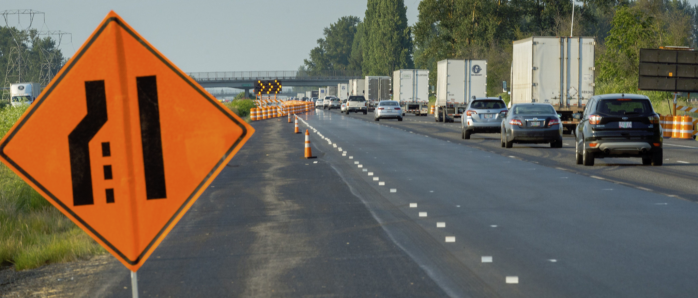
Merging Branches in Git
“Merge ahead” by Oregon Department of Transportation is licensed under CC BY 2.0 DEED / Cropped from original
Notes:
“Merge ahead” by Oregon Department of Transportation is licensed under CC BY 2.0 DEED / Cropped from original
https://flic.kr/p/2g6gwVE

Slide 2
We always…
Merge one branch into another branch
Example:
Merge bug-fix into main
Only the main branch will change, not the bug-fix branch

Slide 3
Three Merge Scenarios
➀ Fast-Forward
True Merge
➁ Auto-Merge Successful
➂ Auto-Merge Conflict

Slide 4
Fast-Forward Example
* a3b25e7 (HEAD -> main)
* e41c5b6

Slide 5
Create a new branch
git branch fix-bug
* a3b25e7 (HEAD -> main)
* e41c5b6

Slide 6
Create a new branch
git branch fix-bug
* a3b25e7 (HEAD -> main, fix-bug)
* e41c5b6

Slide 7
Switch to the new branch
git switch fix-bug
* a3b25e7 (HEAD -> main, fix-bug)
* e41c5b6

Slide 8
Switch to the new branch
git switch fix-bug
* a3b25e7 (main, HEAD -> fix-bug)
* e41c5b6

Slide 9
Add a new commit
Modify files in the working tree
git add -A
git commit
* a3b25e7 (main, HEAD -> fix-bug)
* e41c5b6

Slide 10
Add a new commit
Modify files in the working tree
git add -A
git commit
* 40f26d8 (HEAD -> fix-bug)
* a3b25e7 (main)
* e41c5b6

Slide 11
Add another commit
Modify files in the working tree
git add -A
git commit
* 40f26d8 (HEAD -> fix-bug)
* a3b25e7 (main)
* e41c5b6

Slide 12
Add another commit
Modify files in the working tree
git add -A
git commit
* 9d63832 (HEAD -> fix-bug)
* 40f26d8
* a3b25e7 (main)
* e41c5b6

Slide 13
Switch to main branch
git switch main
* 9d63832 (HEAD -> fix-bug)
* 40f26d8
* a3b25e7 (main)
* e41c5b6

Slide 14
Switch to main branch
git switch main
* 9d63832 (fix-bug)
* 40f26d8
* a3b25e7 (HEAD -> main)
* e41c5b6

Slide 15
Merge fix-bug branch into main branch
git merge fix-bug
* 9d63832 (fix-bug)
* 40f26d8
* a3b25e7 (HEAD -> main)
* e41c5b6

Slide 16
Fast-Forward Merge
Happens when current branch is ancestor of named branch
Only moves current branch pointer (no new commit)
* 9d63832 (fix-bug)
* 40f26d8
* a3b25e7 (HEAD -> main)
* e41c5b6
Current branch (main) is ancestor of fix-bug

Slide 17
Merge fix-bug branch into main branch
git merge fix-bug
* 9d63832 (fix-bug)
* 40f26d8
* a3b25e7 (HEAD -> main)
* e41c5b6

Slide 18
Merge fix-bug branch into main branch
git merge fix-bug
* 9d63832 (HEAD -> main, fix-bug)
* 40f26d8
* a3b25e7
* e41c5b6
main branch moved
No new commit

Slide 19
Three Merge Scenarios
✓
➀ Fast-Forward
True Merge
➁ Auto-Merge Successful
➂ Auto-Merge Conflict

Slide 20
True Merge Examples
Let’s back up to this configuration…
* 9d63832 (fix-bug)
* 40f26d8
* a3b25e7 (HEAD -> main)
* e41c5b6

Slide 21
True Merge Examples
See what happens if we work on multiple topic branches in parallel…
* 9d63832 (fix-bug)
* 40f26d8
* a3b25e7 (HEAD -> main)
* e41c5b6

Slide 22
Create a new topic branch and switch to it
git switch –c new-feature
* 9d63832 (fix-bug)
* 40f26d8
* a3b25e7 (HEAD -> main)
* e41c5b6

Slide 23
Create a new topic branch and switch to it
git switch –c new-feature
* 9d63832 (fix-bug)
* 40f26d8
* a3b25e7 (main, HEAD -> new-feature)
* e41c5b6

Slide 24
Add a new commit
Modify files in the working tree
git add -A
git commit
* 9d63832 (fix-bug)
* 40f26d8
* a3b25e7 (main, HEAD -> new-feature)
* e41c5b6

Slide 25
Add a new commit
Modify files in the working tree
git add -A
git commit
* f67da0f (HEAD -> new-feature)
* | 9d63832 (fix-bug)
* | 40f26d8
|/
* a3b25e7 (main)
* e41c5b6

Slide 26
Fast-forward merge new-feature into main
git switch main
git merge new-feature
* f67da0f (HEAD -> new-feature)
* | 9d63832 (fix-bug)
* | 40f26d8
|/
* a3b25e7 (main)
* e41c5b6

Slide 27
Fast-forward merge new-feature into main
git switch main
git merge new-feature
* f67da0f (HEAD -> main, new-feature)
* | 9d63832 (fix-bug)
* | 40f26d8
|/
* a3b25e7
* e41c5b6

Slide 28
Merge fix-bug into main
git merge fix-bug
* f67da0f (HEAD -> main, new-feature)
* | 9d63832 (fix-bug)
* | 40f26d8
|/
* a3b25e7
* e41c5b6

Slide 29
True Merge
Note: main is not an ancestor of fix-bug
Will ultimately result in a new commit
* f67da0f (HEAD -> main, new-feature)
* | 9d63832 (fix-bug)
* | 40f26d8
|/
* a3b25e7
* e41c5b6

Slide 30
True Merge
git merge will attempt to auto-merge files
Possible outcomes: success or merge conflict
Merge conflicts must be resolved by developer
* f67da0f (HEAD -> main, new-feature)
* | 9d63832 (fix-bug)
* | 40f26d8
|/
* a3b25e7
* e41c5b6

Slide 31
Auto-Merge Successful Scenario
Merge fix-bug into main
git merge fix-bug
* f67da0f (HEAD -> main, new-feature)
* | 9d63832 (fix-bug)
* | 40f26d8
|/
* a3b25e7
* e41c5b6

Slide 32
Auto-Merge Successful Scenario
Merge fix-bug into main
git merge fix-bug
Auto-merging …
Merge made …
* f67da0f (HEAD -> main, new-feature)
* | 9d63832 (fix-bug)
* | 40f26d8
|/
* a3b25e7
* e41c5b6

Slide 33
Auto-Merge Successful Scenario
Merge fix-bug into main
git merge fix-bug
* 19fe66b (HEAD -> main)
|\
| * f67da0f (new-feature)
* | 9d63832 (fix-bug)
* | 40f26d8
|/
* a3b25e7
* e41c5b6

Slide 34
Three Merge Scenarios
✓
➀ Fast-Forward
True Merge
✓
➁ Auto-Merge Successful
➂ Auto-Merge Conflict

Slide 35
Merge Conflict Scenario
Merge fix-bug into main
git merge fix-bug
* f67da0f (HEAD -> main, new-feature)
* | 9d63832 (fix-bug)
* | 40f26d8
|/
* a3b25e7
* e41c5b6

Slide 36
Merge Conflict Scenario
Merge fix-bug into main
git merge fix-bug
Auto-merging …
CONFLICT: Merge conflict …
Automatic merge failed …
* f67da0f (HEAD -> main, new-feature)
* | 9d63832 (fix-bug)
* | 40f26d8
|/
* a3b25e7
* e41c5b6

Slide 37
Merge Conflict Scenario
Fix conflicts and commit
Modify files in the working tree to resolve conflicts
git add -A
git commit
* f67da0f (HEAD -> main, new-feature)
* | 9d63832 (fix-bug)
* | 40f26d8
|/
* a3b25e7
* e41c5b6

Slide 38
Merge Conflict Scenario
Fix conflicts and commit
Modify files in the working tree to resolve conflicts
git add -A
git commit
* 19fe66b (HEAD -> main)
|\
| * f67da0f (new-feature)
* | 9d63832 (fix-bug)
* | 40f26d8
|/
* a3b25e7
* e41c5b6

Slide 39
Three Merge Scenarios
✓
➀ Fast-Forward
True Merge
✓
➁ Auto-Merge Successful
✓
➂ Auto-Merge Conflict

Slide 40

Summary
Three merge scenarios
Fast-forward merge
True merge
  Auto-merge successful
  Merge conflict
Let’s do an activity!
http://flic.kr/p/aCLor3

