Slide 1
How a basic webpage request is processed Dataflow view

Slide 2
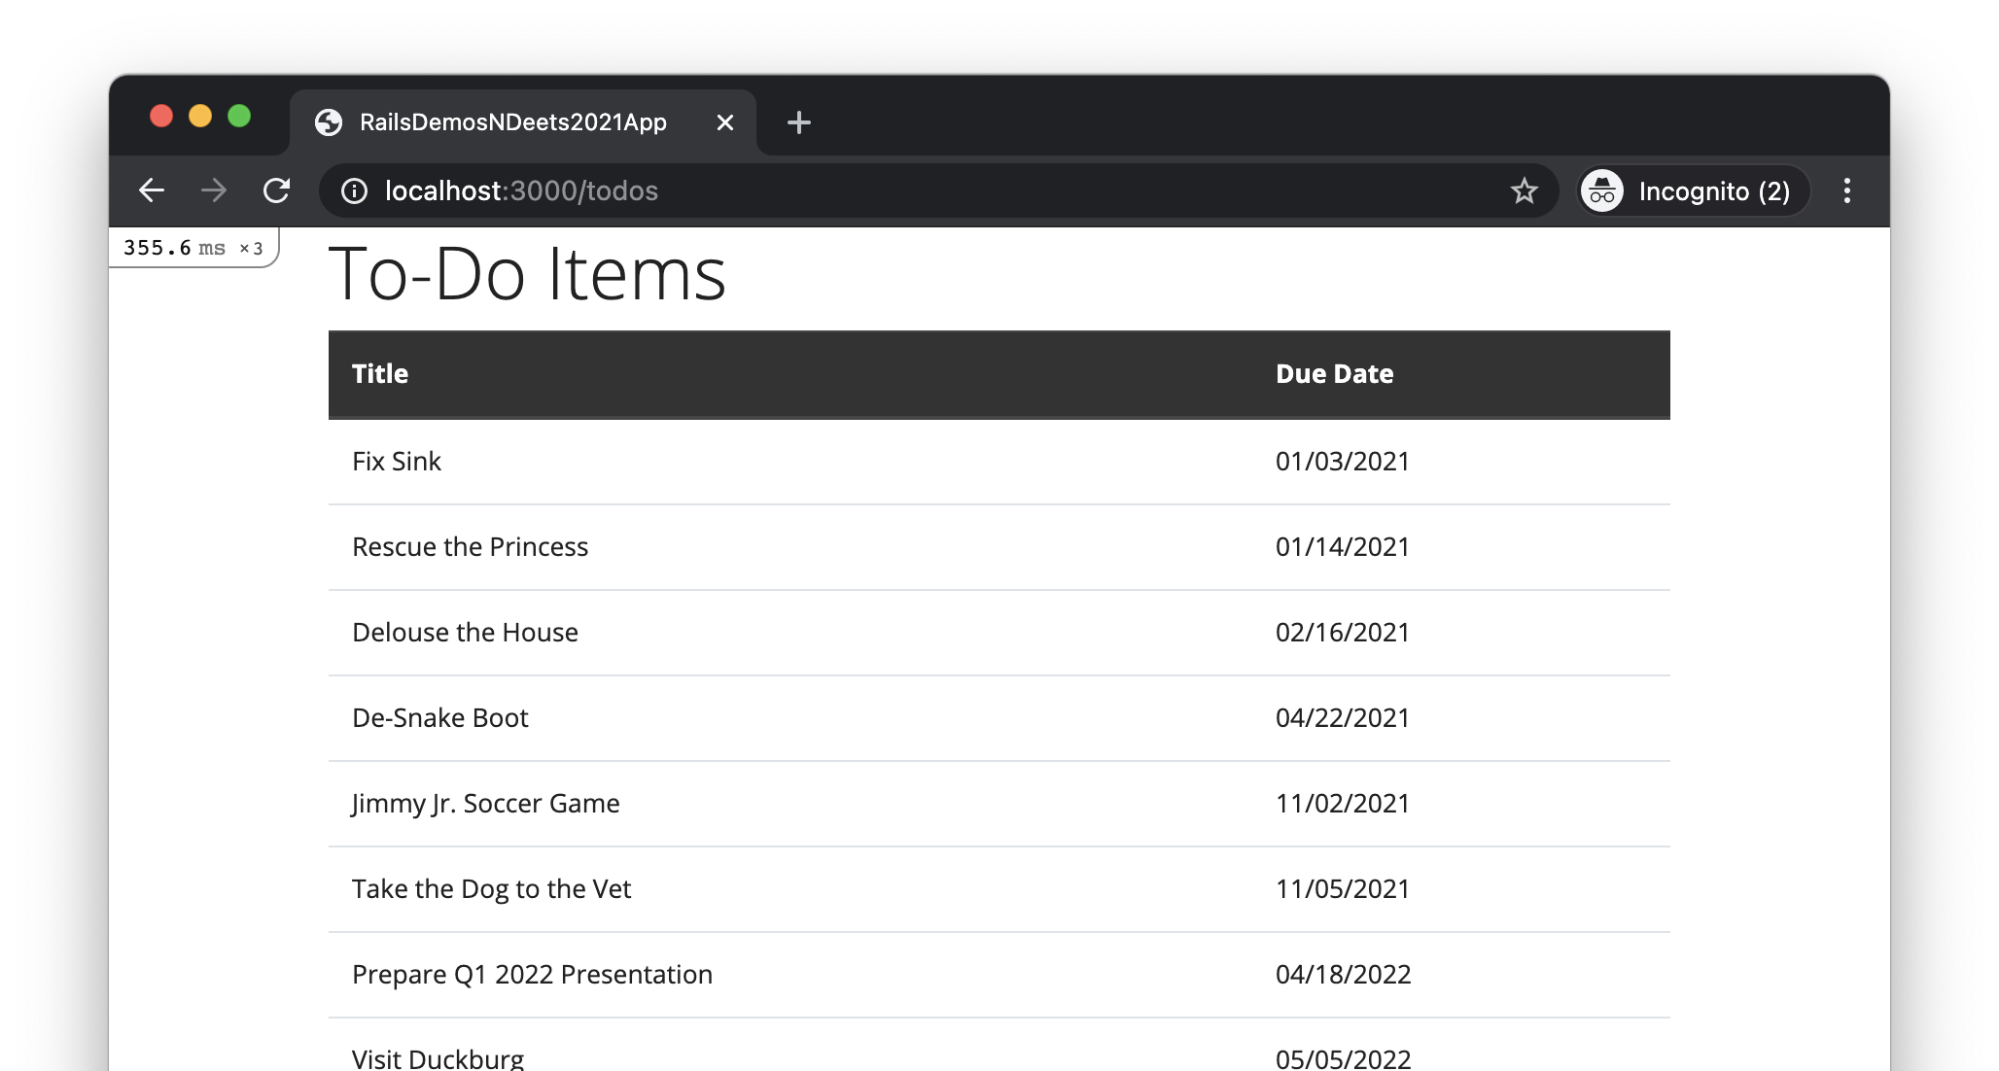
User enters URL into location bar

Slide 3
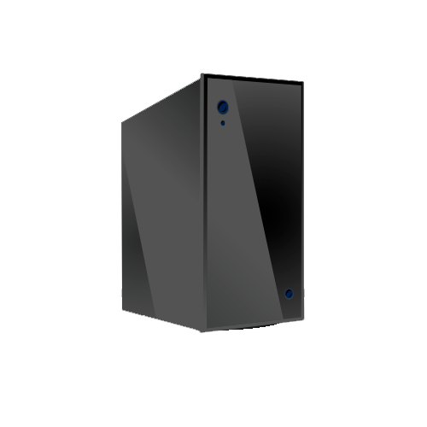
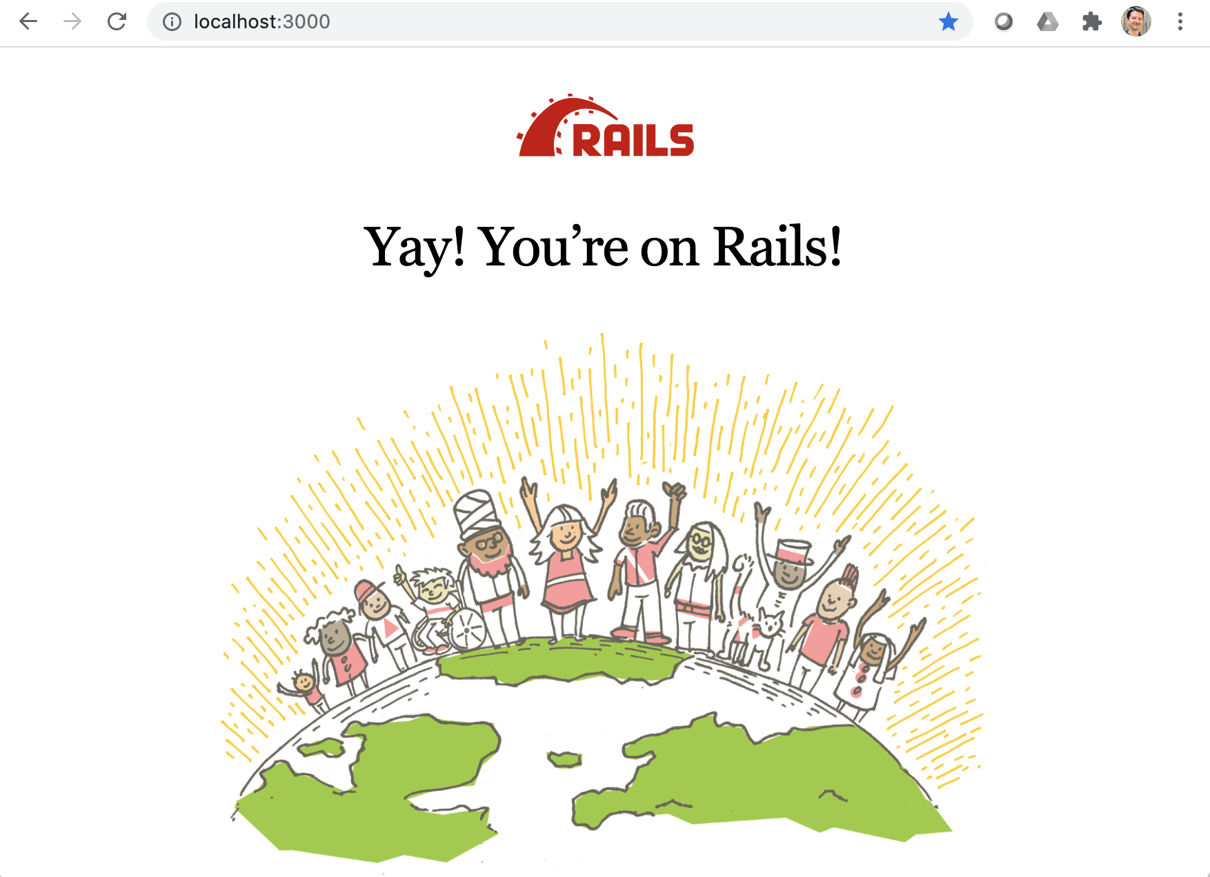
Ye Olde Internet
Web Server
Browser sends HTTP GET request
Browser
Router
Controller
View
Model
DB

Slide 4
HTTP Request Sent to Web Server
HTTP Request Method/Verb
Resource Path
HTTP Version
Request Headers

Slide 5
Ye Olde Internet
Web Server
Browser sends HTTP GET request
Browser
Router
Controller
View
Model
DB

Slide 6
Ye Olde Internet
Web Server
Router looks up route that matches the request, and calls controller action
Browser
Router
Controller
View
Model
DB

Slide 7
For HTTP GET requests with “home” as resource path…
… call the home method of the PagesController class

Slide 8
Ye Olde Internet
Web Server
Router looks up route that matches the request, and calls controller action
Browser
Router
Controller
View
Model
DB

Slide 9
Ye Olde Internet
Web Server
Browser
Router
Controller action renders a view template
Controller
View
Model
DB

Slide 10
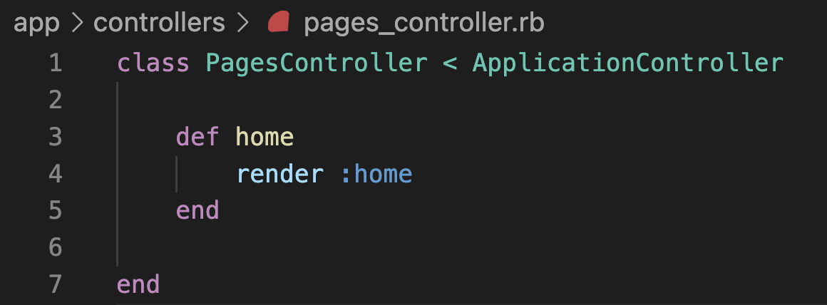
Tells Rails which view template to render

Slide 11
Look for view template in app/views/pages/ folder
Look for view template named home.html.erb

Slide 12
Ye Olde Internet
Web Server
Browser
Router
Controller action renders a view template
Controller
View
Model
DB

Slide 13
Ye Olde Internet
Web Server
Browser
Router
View template generates HTML
Controller
View
Model
DB

Slide 14
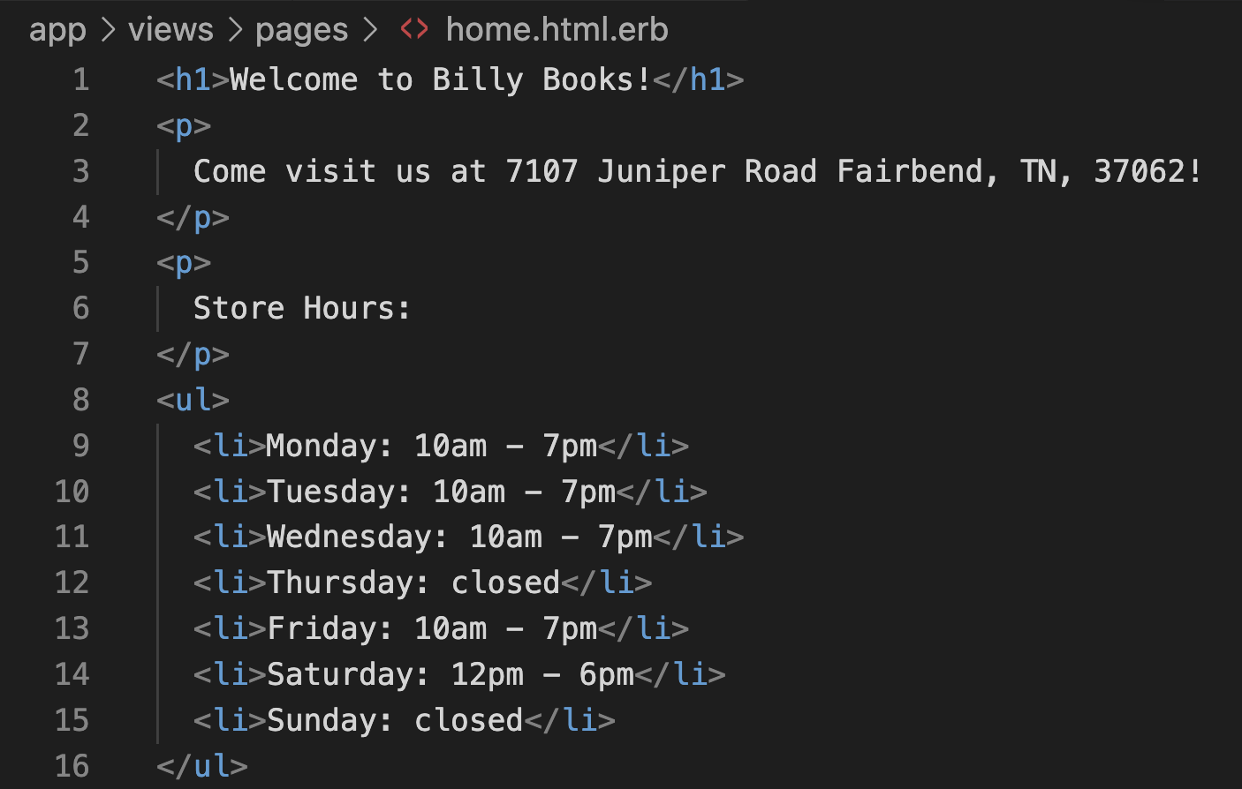

Slide 15
Ye Olde Internet
Web Server
Browser
Router
View template generates HTML
Controller
View
Model
DB

Slide 16
Ye Olde Internet
Web Server
Controller sends an HTTP response, containing the generated HTML, to the browser
Browser
Router
Controller
View
Model
DB

Slide 17
HTTP Response Sent to Web Browser
HTTP Version
Status Code and Text Version
Response Headers

Slide 18
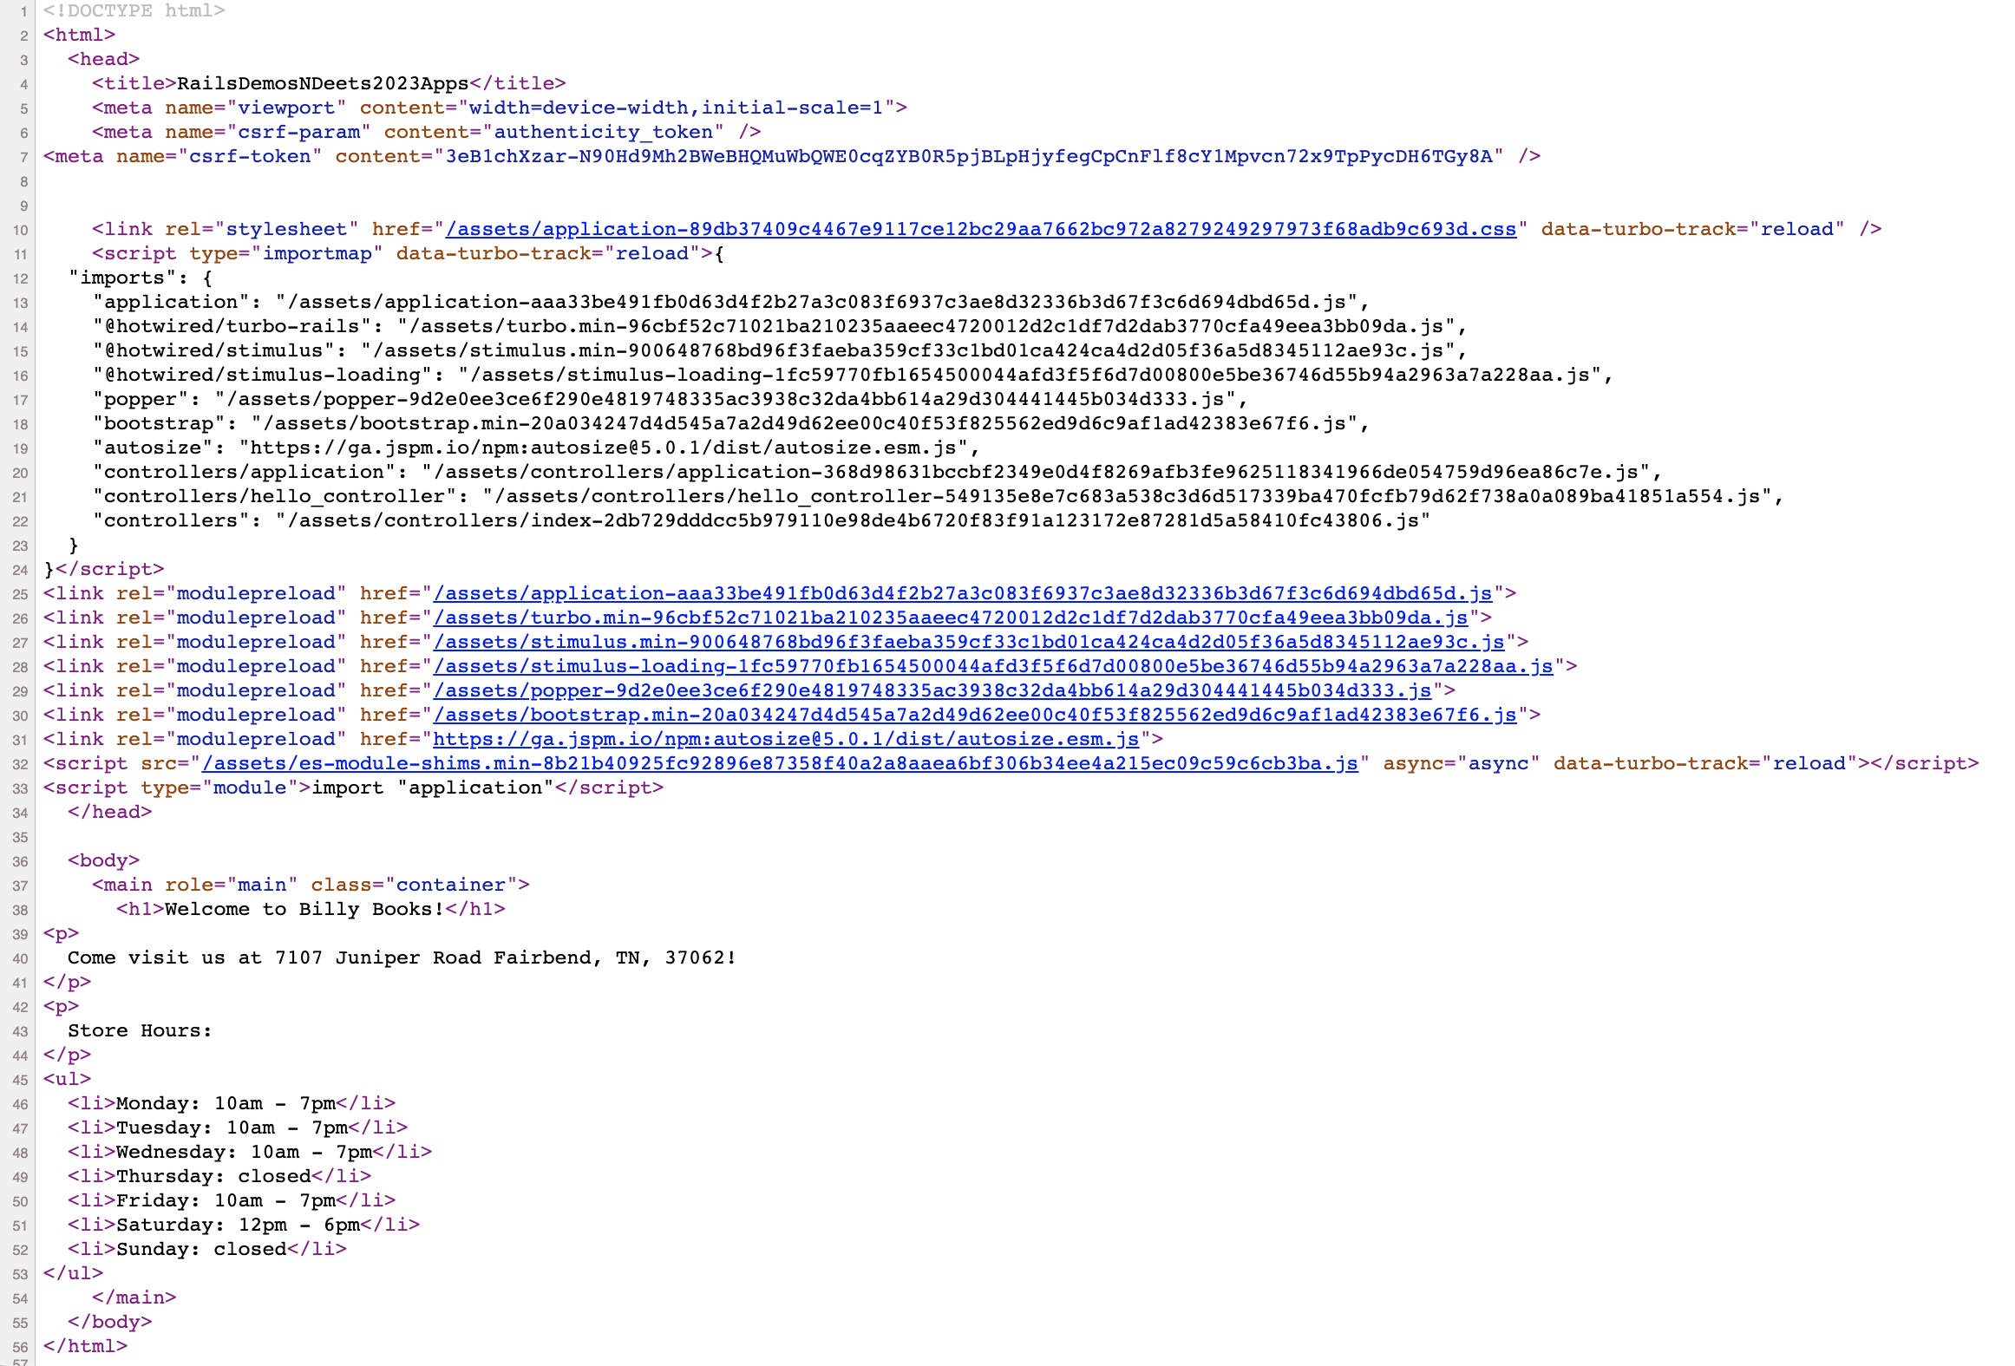
HTTP Response Body Sent to Web Browser

Slide 19
Ye Olde Internet
Web Server
Controller sends an HTTP response, containing the generated HTML, to the browser
Browser
Router
Controller
View
Model
DB

Slide 20
Browser displays a webpage based on the HTML received
Ye Olde Internet
Web Server
Browser
Router
Controller
View
Model
DB

Slide 21
