Slide 1
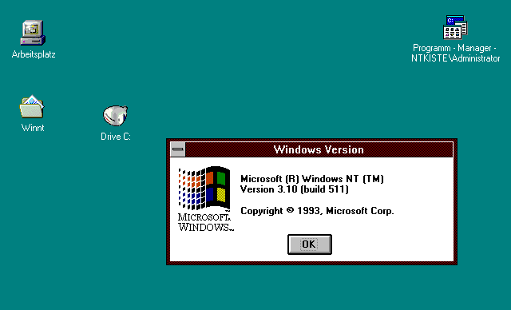
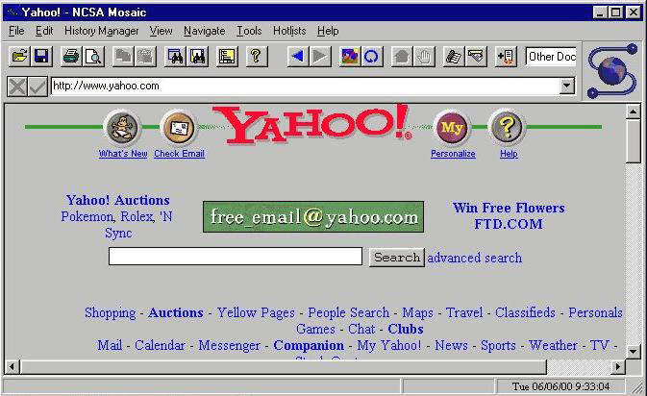
http://www.computerhistory.org/timeline/images/1993_mosaic_browser_large.jpg
HTML and HTTP
Notes:
1993 version of Mosaic browser.
Loading Yahoo! from June 2000 (see lower right of browser window).

Slide 2
Overview
HTML – How webpages are made
HTTP – How the web works

Slide 3
Overview
HTML – How webpages are made
HTTP – How the web works

Slide 4
What is HTML?
Implies links
Implies formatting tags
HyperText Markup Language
Main language for writing web pages that
can be displayed in a web browser

Slide 5
Web Pages = 3 Technologies
HTML for Structure
Cascading Style Sheets (CSS) for Style
JavaScript for Behavior

Slide 6
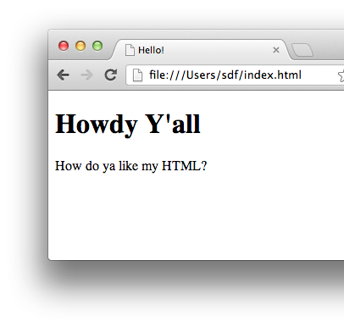
How HTML Works
You write HTML text
Then load it in a browser
<!DOCTYPE html>
<html>
<head>
<title>Hello!</title>
</head>
<body>
<h1>Howdy Y'all</h1>
<p>
How do ya like my HTML?
</p>
</body>
</html>

Slide 7
HTML Elements
Start tag
End tag
<p>This is a paragraph.</p>
Renders as
Note slash!
This is a paragraph.

Slide 8
Elements can be nested
Nested element
<p>This is a <b>paragraph</b>.</p>
Renders as
This is a paragraph.

Slide 9
Elements can have attributes
Attribute
<p style="color:blue">I'm blue!</p>
Renders as
Attribute name
I’m blue!
Equals
Value string

Slide 10
HTML Page Structure
Doctype info
<!DOCTYPE html>
<html>
<head>
<title>Hello!</title>
</head>
<body>
<h1>Howdy Y'all</h1>
<p>
How do ya like my HTML?
</p>
</body>
</html>
head element for metadata
html element
body element for content

Slide 11
Oh yeah, and …
A few tags don’t come in pairs:
E.g.: <br> for line breaks
E.g.: <img> for images
Browsers collapse whitespace (spaces, newlines):
Consecutive whitespace treated as single space
Leading/trailing whitespace eliminated
Special symbols:
E.g.: &nbsp; for non-breaking space
See: http://www.w3schools.com/html/html_entities.asp and http://www.w3schools.com/tags/ref_symbols.asp

Slide 12
Now, all you need to do is learn these tags: http://www.w3schools.com/tags/ref_byfunc.asp (Ignore the “not supported” ones)

Slide 13
Overview
HTML – How webpages are made
HTTP – How the web works

Slide 14
Overview
HTML – How webpages are made
HTTP – How the web works

Slide 15
So how does the Web work? When you open a web page in your browser, where does that HTML come from, and how does it get to your browser?

Slide 16
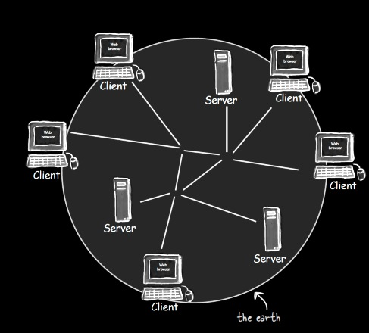
Client-Server Architecture of the Web
From Head First Servlets and JSP (2nd edition), p. 4
Head First Servlets and JSP (2nd edition), p. 3

Slide 17
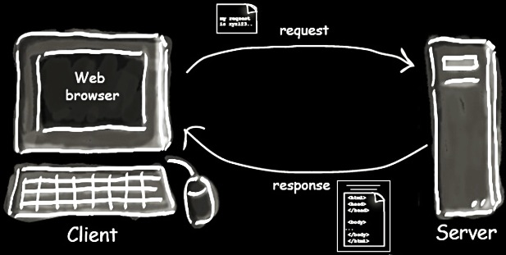
Client-Server Interaction
From Head First Servlets and JSP (2nd edition), p. 4

Slide 18
How do you tell a browser to send a request to a particular server?
?
Head First Servlets and JSP (2nd edition), p. 3

Slide 19
URL (Uniform Resource Locator)
http://www.wickedlysmart.com:80/beeradvice/select/beer1.html
Port (optional)
Resource Path
Protocol (http, https, etc.)
Domain Name (web server)

Slide 20
What protocol do these interactions follow?
Head First Servlets and JSP (2nd edition), p. 4

Slide 21
HTTP (Hypertext Transfer Protocol)
Request “methods” or “verbs”
GET: Retrieve resource
POST: Create resource
PATCH: Update resource
DELETE: Destroy resource
… more …
Response (only one type)
CRUD: 4 basic operations of persistent storage

Slide 22
Example HTTP GET Request
HTTP Method
Path to resource
Protocol version
GET /select/selectBeerTaste.jsp HTTP/1.1
Host: www.wickedlysmart.com
User-Agent: Mozilla/5.0 (Macintosh; U; PPC Mac OS X…
Accept: text/xml,application/xml,application/xhtml+xml…
Accept-Language: en-us,en;q=0.5
Accept-Encoding: gzip,deflate
Accept-Charset: ISO-8859-1,utf-8;q=0.7,*;q=0.7
Keep-Alive: 300
Connection: keep-alive
Request headers

Slide 23
Example HTTP Response
Protocol version
HTTP status code
Text version of status code
HTTP/1.1 200 OK
Content-Type: text/html
Content-Length: 397
Date: Wed, 19 Nov 2003 03:25:40 GMT
Server: Apache-Coyote/1.1
Connection: close
<html>
…
</html>
Response headers
Response
body

Slide 24
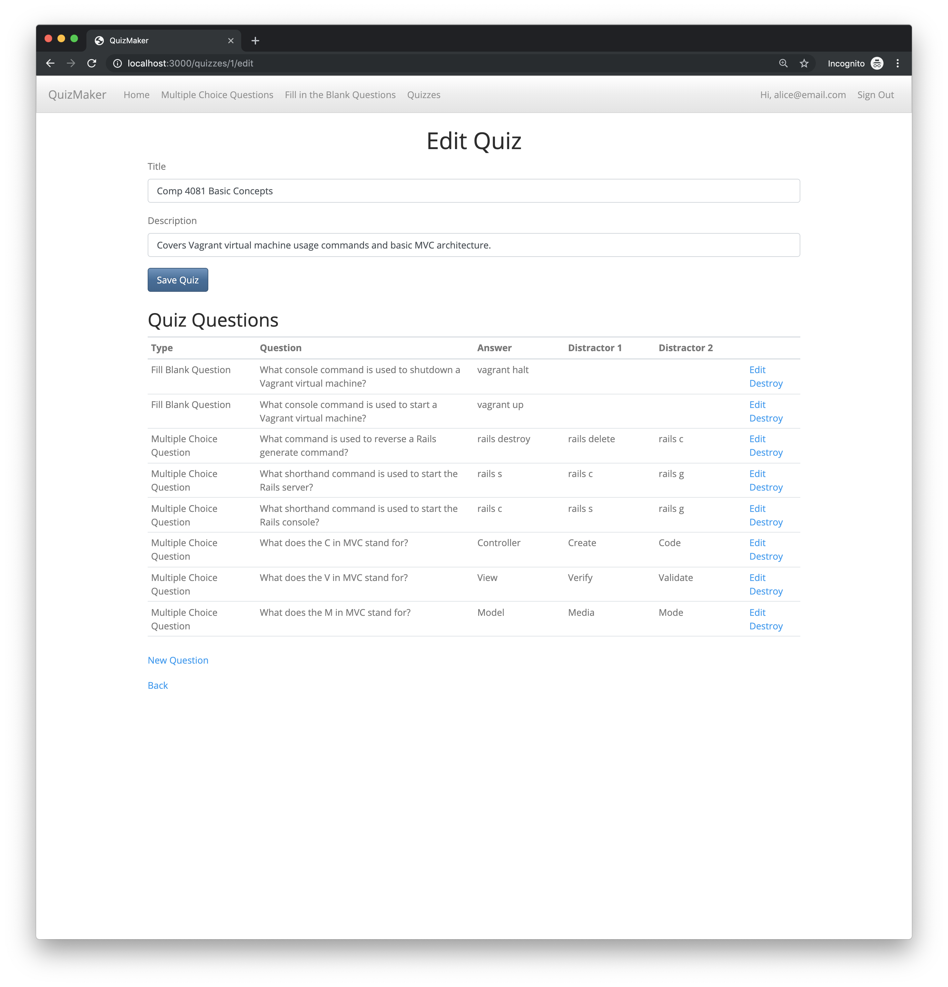
Coding Apps in Rails = Creating a Custom Server
Define how to respond to different requests
Define HTML to be sent to clients
Browser
Rails Server
HTTP Requests
HTTP Responses

Slide 25
Summary
How to code HTML
How HTTP and the Web works
http://flic.kr/p/aCLor3

