Slide 1
http://flic.kr/p/7u4Xr2
Software Engineering Process

Slide 2
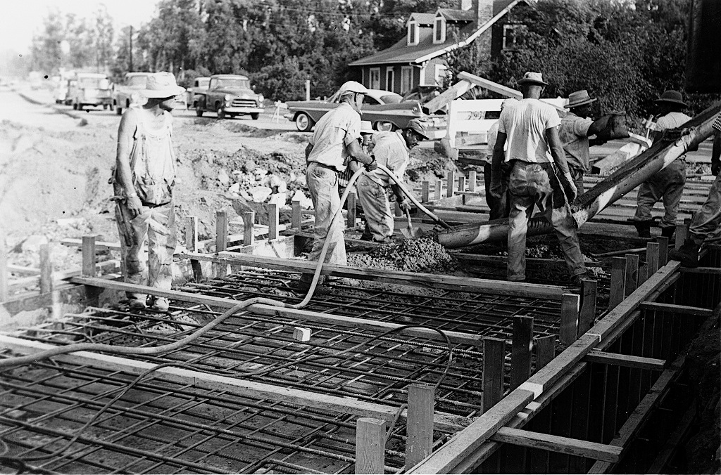
Engineering software is a Big Job
http://flic.kr/p/7GereG
http://flic.kr/p/5w9rXP
Many requirements to gather and discuss
Many aspects of the system to design
Many features to construct
Many automated tests to write and run
And a whole lot more!

Slide 3
Practical issue: What order should tasks be done in?
That is, what process to use?

Slide 4
The classic way: Waterfall (sequential) model
Requirements
But often a bad way…
Design
Implementation
Verification
Maintenance
http://en.wikipedia.org/wiki/File:Waterfall_model_%281%29.svg
Notes:
60s and 70s-era advice

Slide 5
What could go wrong?
Requirements
6 months
Design
6 months
Implementation
3 months
Verification
6 months
Release!
http://en.wikipedia.org/wiki/File:Waterfall_model_%281%29.svg

Slide 6
What could go wrong?
Problem!
Requirements
6 months
Design
6 months
Implementation
I don’t like it…
3 months
Verification
6 months
Release!
Customer
http://en.wikipedia.org/wiki/File:Waterfall_model_%281%29.svg
Notes:
60s and 70s-era advice

Slide 7
Why Waterfall doesn’t work
False assumption: Specifications are …
predictable – can be correctly defined at the start
stable – have low change rates
Actual stats:
25% of requirements changed 😱
35% to 50% changed in large projects 😱 😱

Slide 8
Solution: Empirical Process Model
Feedback
Adaptation

Slide 9
Iterative & Incremental Development Process
Analysis &
Design
Requirements
Initial
Planning
Planning
Implementation
Deployment
Evaluation
Testing

Slide 10
Iterative & Incremental Development Process
repeated cycles
Analysis &
Design
Requirements
Initial
Planning
Planning
Implementation
Deployment
Evaluation
Testing

Slide 11
Iterative & Incremental Development Process
build up small portions at a time
Analysis &
Design
Requirements
Initial
Planning
Planning
Implementation
Deployment
Evaluation
Testing

Slide 12
Iterative & Incremental Development Process
Analysis &
Design
Requirements
Initial
Planning
Planning
Implementation
Where are
feedback
&
adaptation?
Deployment
Evaluation
Testing

Slide 13
Iterative & Incremental Development Process
Analysis &
Design
Requirements
Initial
Planning
Adaptation
Planning
Implementation
Feedback
Deployment
Evaluation
Testing

Slide 14
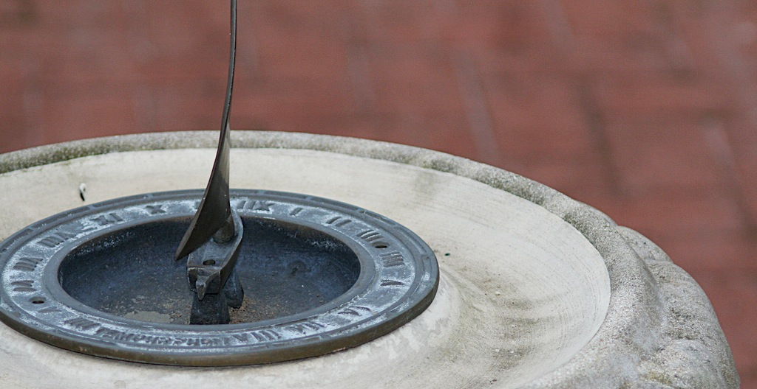
How long should iterations be?
Short is good
2 to 6 weeks
1 is too short to get meaningful feedback
Long iterations subvert the core motivation
http://flic.kr/p/368zW7

Slide 15
Key Benefits of Iterative & Incremental Development
Early visible progress (no “analysis paralysis”)
Early mitigation of risk
Fail fast, catch changing requirements quickly
Iterative process improvement

Slide 16
Our Project Iterations?
Analysis &
Design
Requirements
M0
Initial
Planning
M1
Planning
Implementation
Deployment
Evaluation
Testing

Slide 17
Summary
Software Engineering Process
Waterfall Process Model
Empirical Process Model
Iterative & Incremental Development Process
http://flic.kr/p/aCLor3

Slide 18
Appendix

Slide 19
Iterative Development Process
We are here – how to proceed?
Analysis
Design
Implementation
Requirements
Planning
Initial Planning
Testing
Evaluation
Deployment

Slide 20
Developer
Customer
Requirements
Create USs
Estimate USs
USs + Estimates
Prioritize USs
USs + Estimates + Priorities
Choose USs for Iteration
Divide Chosen USs into Tasks
Assign Tasks to Workers
Get to Work!

Slide 21
Developer
Customer
Requirements
Create USs
Estimate USs
USs + Estimates
Prioritize USs
USs + Estimates + Priorities
Choose USs for Iteration
Divide Chosen USs into Tasks
Assign Tasks to Workers
Get to Work!

Slide 22
Estimation is Hard
http://xkcd.com/1658/

Slide 23
Principles for Estimation
Principle: Estimates for smaller, more-immediate tasks tend to be more accurate than ones for larger, more-future tasks
Principle: Past performance is the best indicator of future performance
Approach: Track your outcomes; refine your estimates
Principle: Wisdom of the crowd
Goal: Predict how events will unfold
Think event planning
Problem: Easy to miss something
Solution: More brains = more opportunities to catch eventualities

Slide 24
Planning Poker Estimation using Wisdom of the Crowd
Cards with days of work
For each US:
Discuss work involved
Flip cards
Repeat until consensus
Efficiency in estimating is important
Don’t expect your estimates to be super accurate

Slide 25
Here’s a video demonstration of planning poker:
http://youtu.be/0FbnCWWg_NY
Here’s a planning poker web app:
https://planningpokeronline.com/

Slide 26
Developer
Customer
Requirements
Create USs
Estimate USs
USs + Estimates
Prioritize USs
USs + Estimates + Priorities
Choose USs for Iteration
Divide Chosen USs into Tasks
Assign Tasks to Workers
Get to Work!

Slide 27
Principle: Customer sets priorities
Ensures alignment with customer goals
Helps customer feel in control
Project isn’t going “off the rails”
Estimates help customer maximize cost-benefit

Slide 28
Priority Numbering Scheme
Multiples of 10:
10 - Highest priority
20
30
40
50
… - Lowest priority
Non-multiples of 10 may be used if helpful

Slide 29
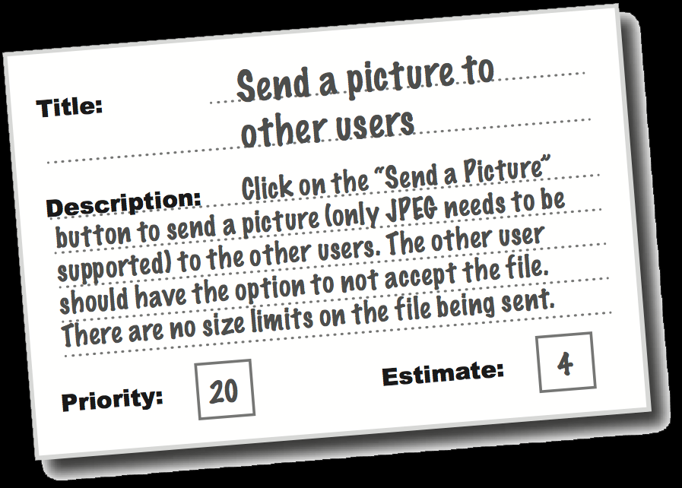
So in the end you have…
Collection of user stories
With estimates
And customer priorities
Now you can plan the next iteration!

Slide 30
Summary
Software Engineering Process
Waterfall Process Model
Empirical Process Model
Customer-Centered Iterative and Incremental Development Process
Estimation (Planning Poker)
Prioritization (numbering scheme)
http://flic.kr/p/aCLor3

